Slide 1
Building a Website
Skills needed
Cut & Paste or Copy & Paste
Inserting Pictures
Word
Power Point
Facebook

Slide 2
Web Designing Software
Site123.com
Wordpress.com
Wordpress.org (HostGator.com)

Slide 3
Site123.com
Wordpress.com
Page Level / Templates
Less Flexible
Few Options
Live Chat
Better Help
Cost More
Block Level / Themes
Very Flexible
More Options
eMail & Live Chat – on level service
Good Help -- only with Live eMail
To get list of block types:
wordpress.com/support/wordpress-editor/blocks/

Slide 4
Wordpress.org (HostGator.com)
Block Level / Themes
Very Flexible
More Options
Can add Plug ins
eMail & Live Chat – on level service
Good Help

Slide 5
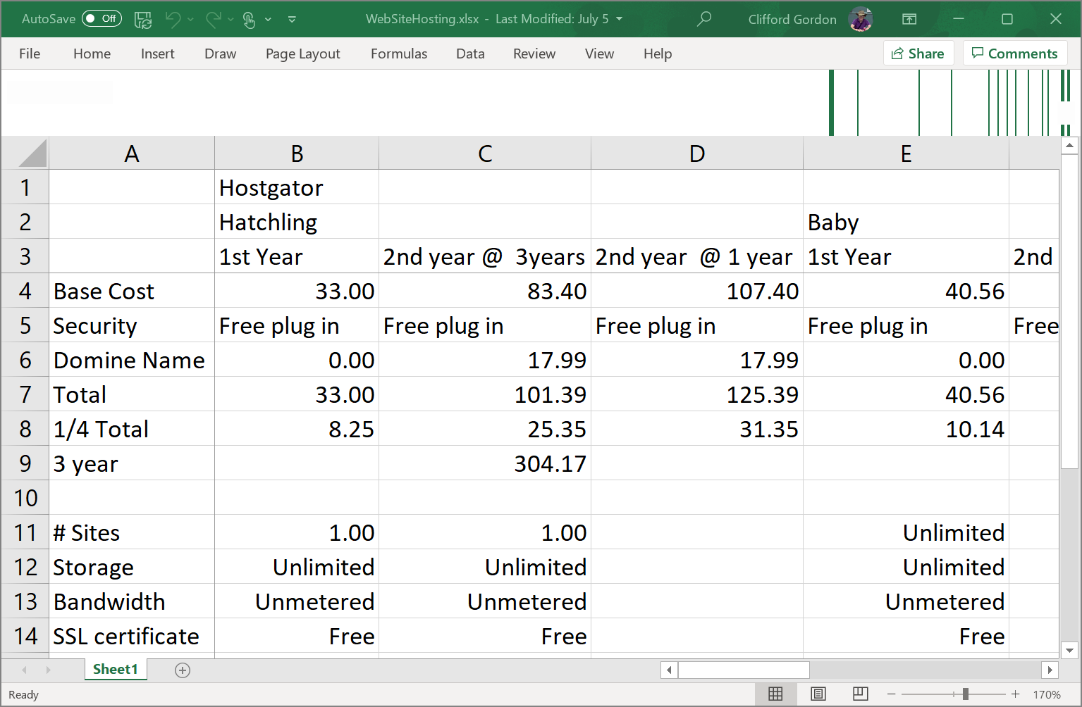

Slide 6
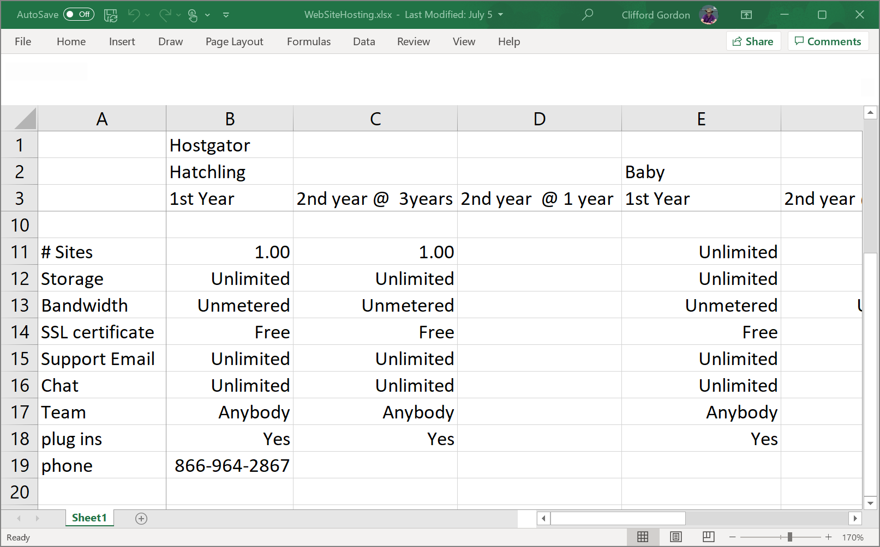

Slide 7
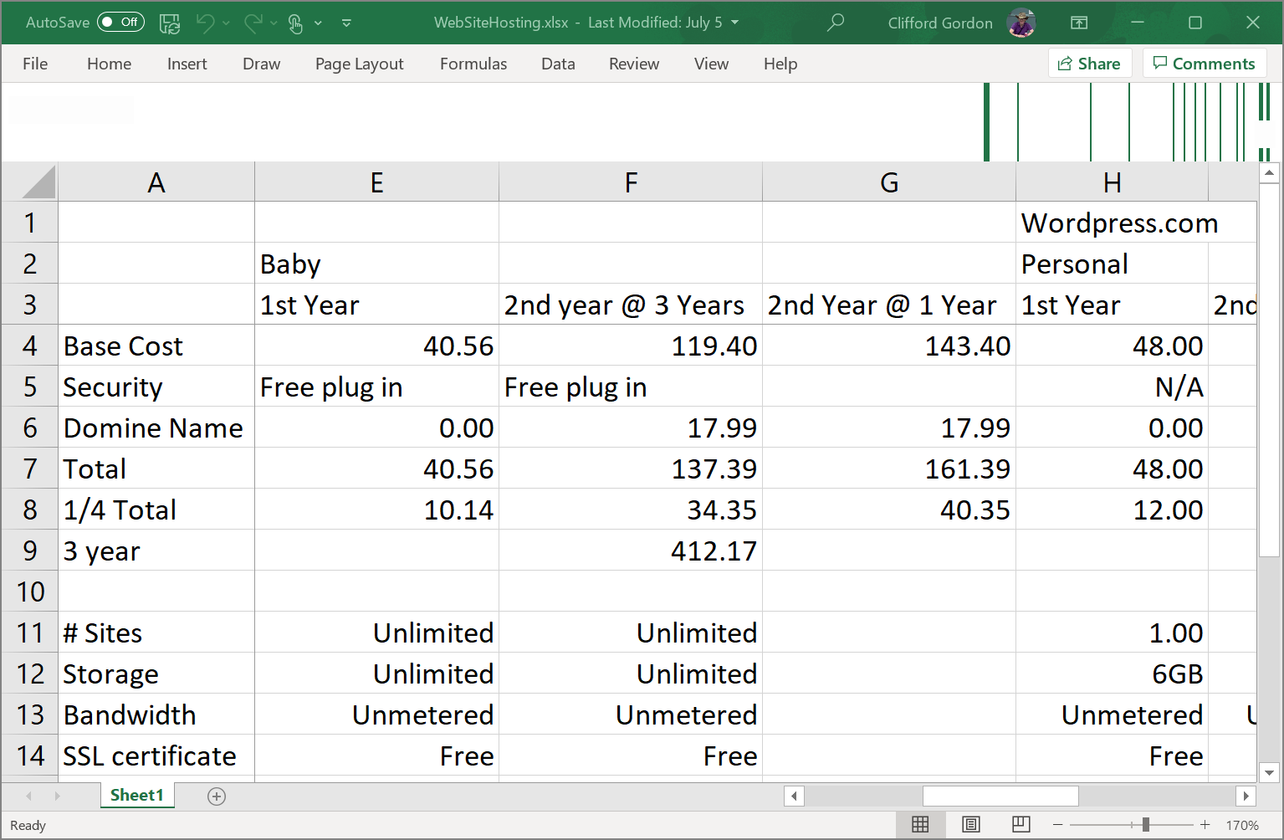

Slide 8
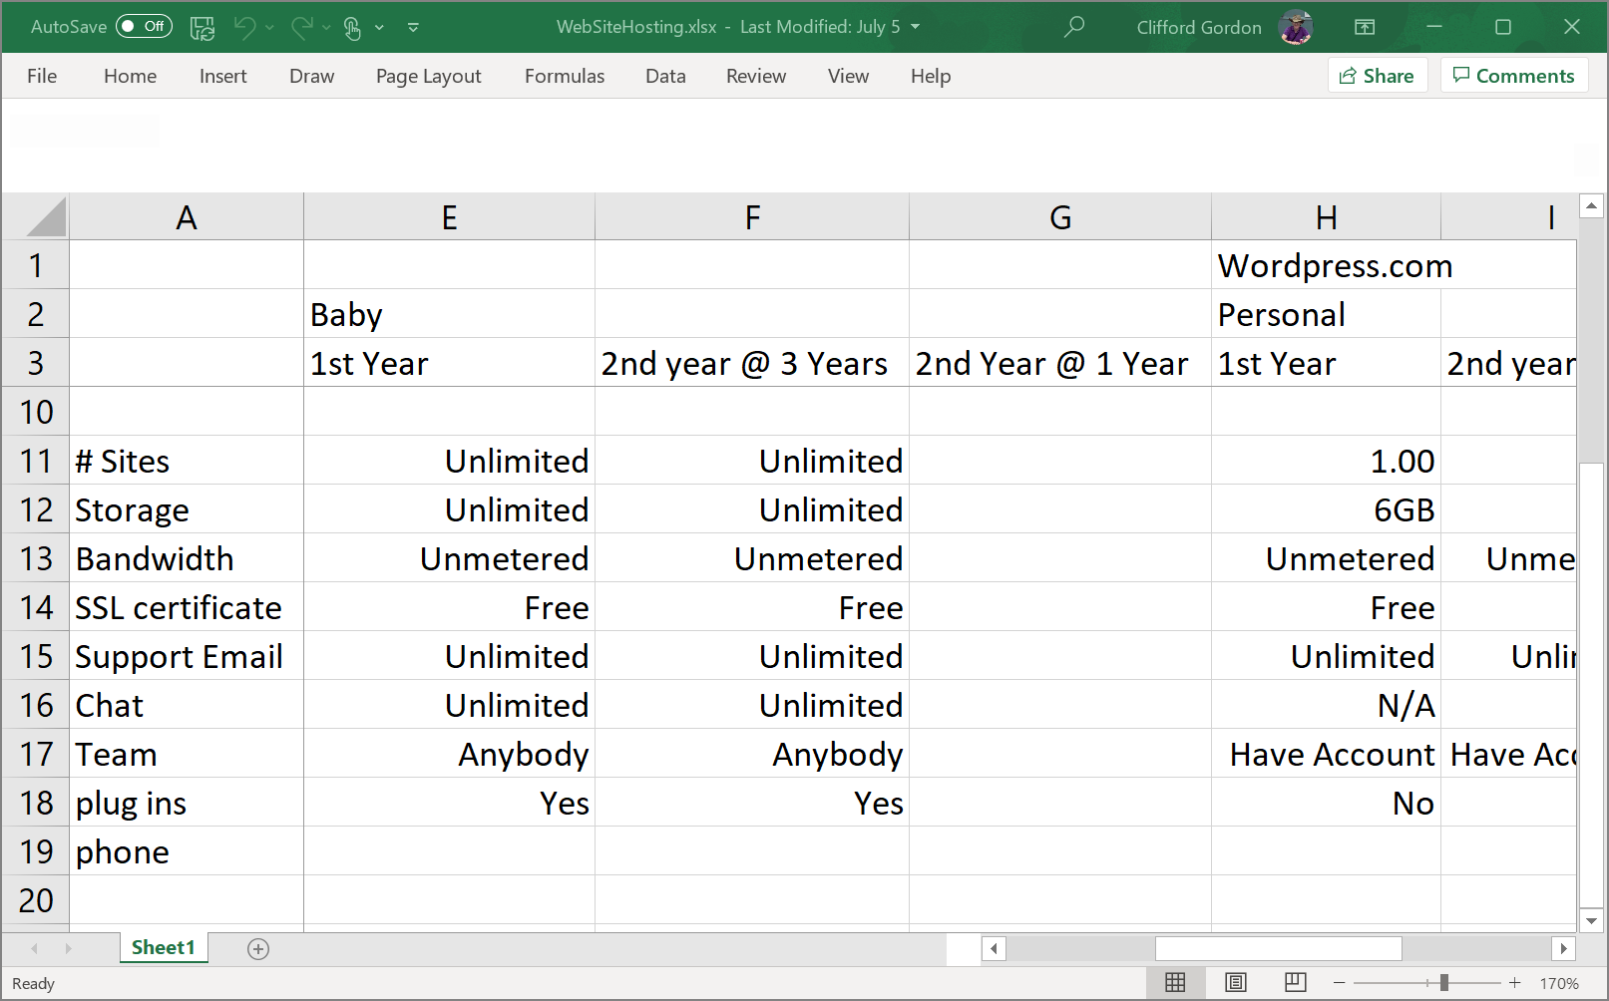

Slide 9
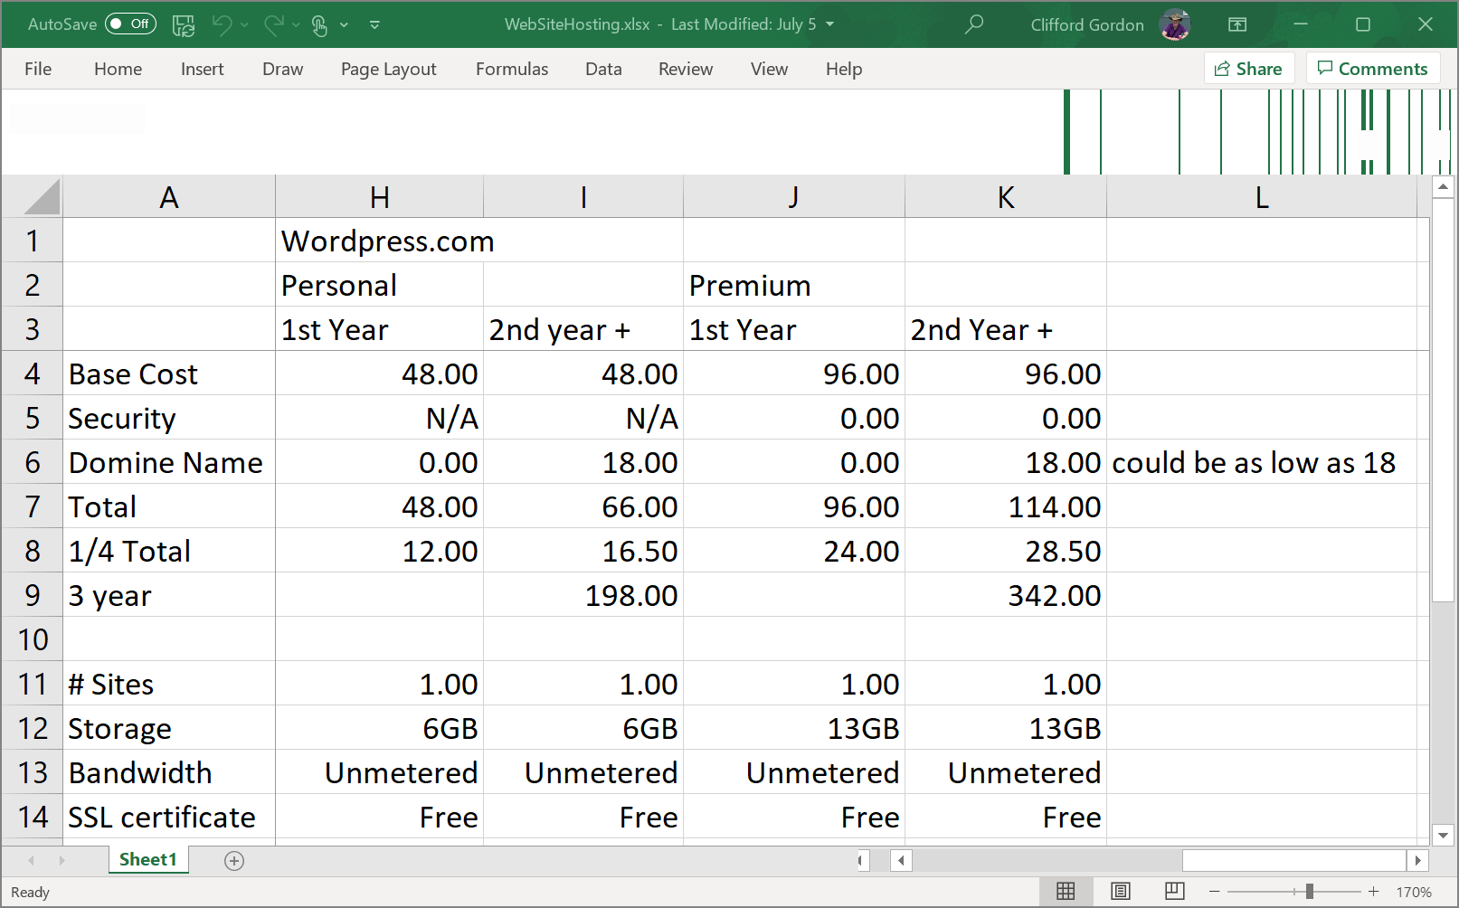

Slide 10
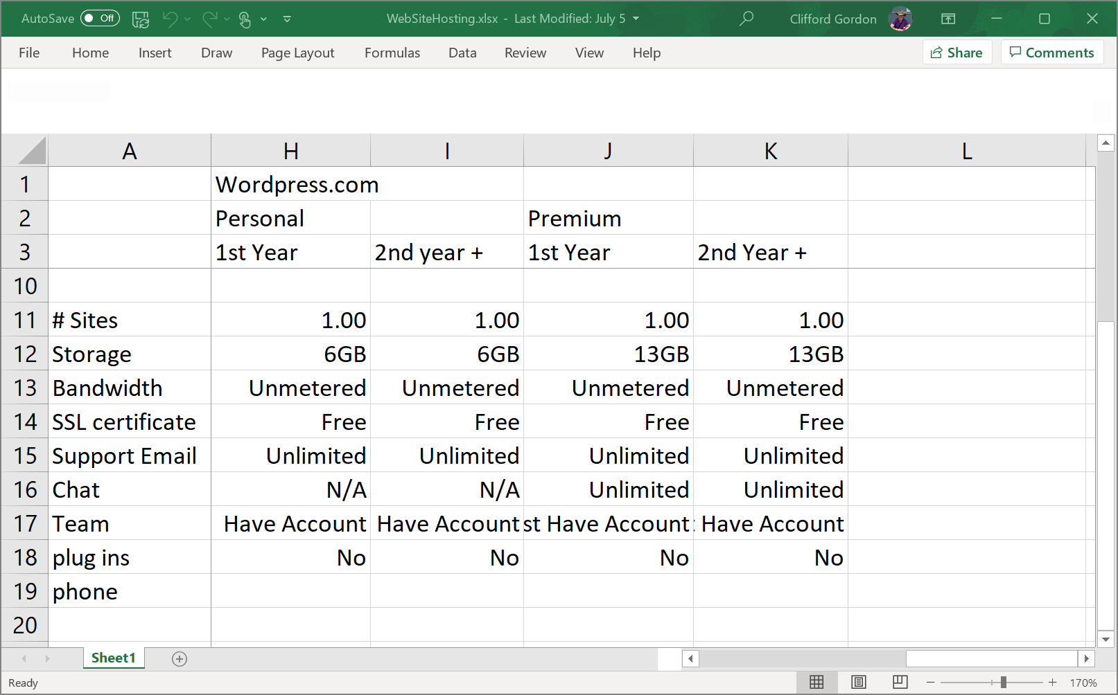

Slide 11
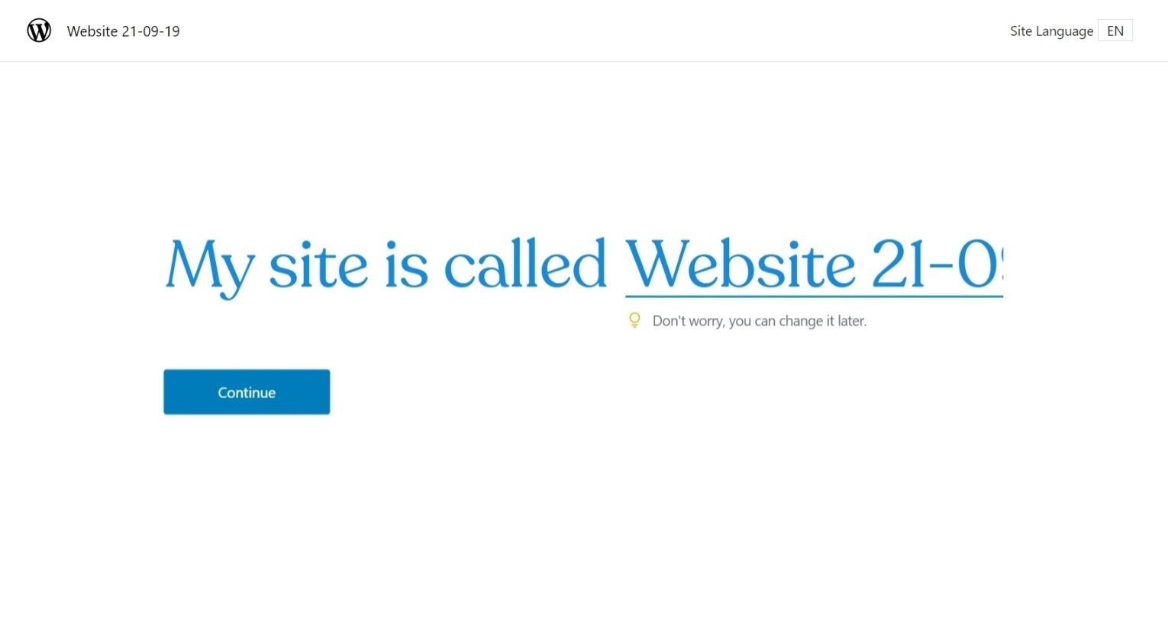
1 st - Enter Web Site Name
Then Left Click on Continue

Slide 12
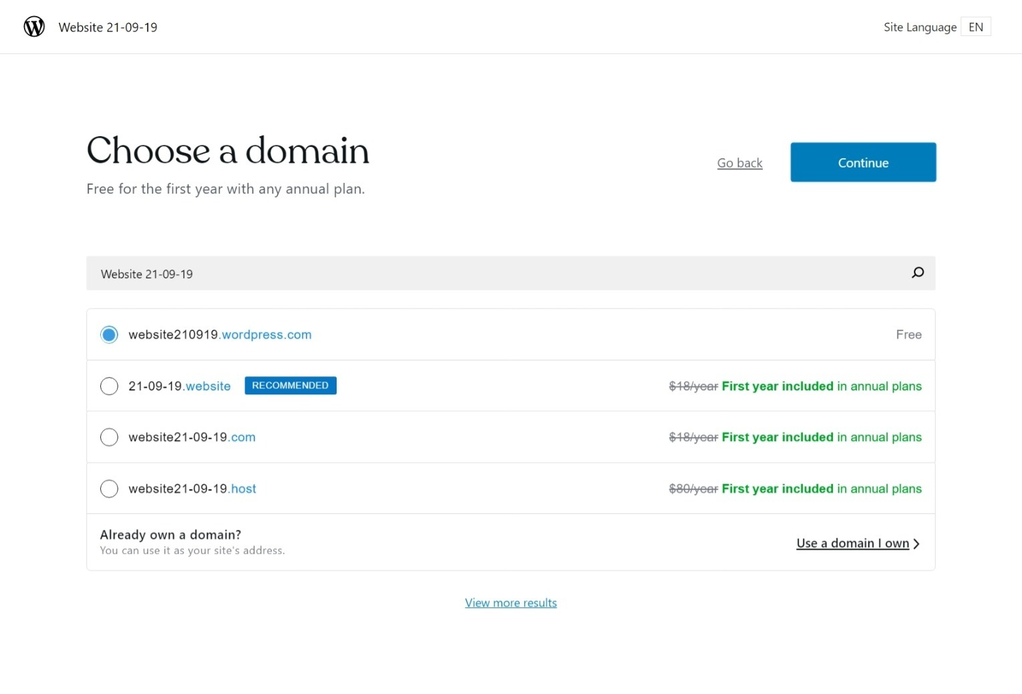
Then Select Continue
1 st - Select this option for free web site

Slide 13
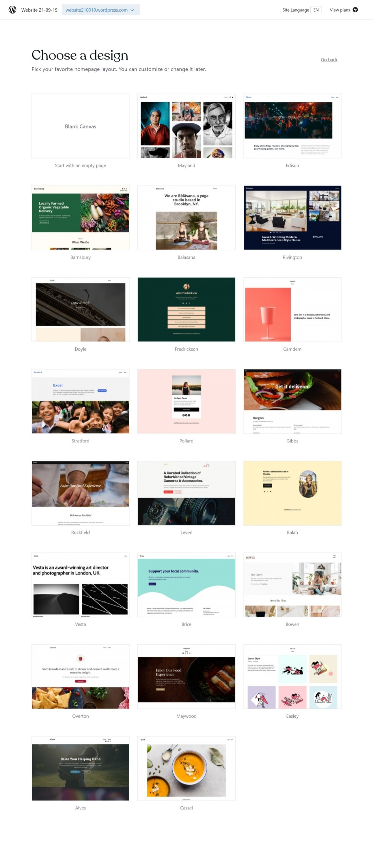
Select Blank Canvas

Slide 14
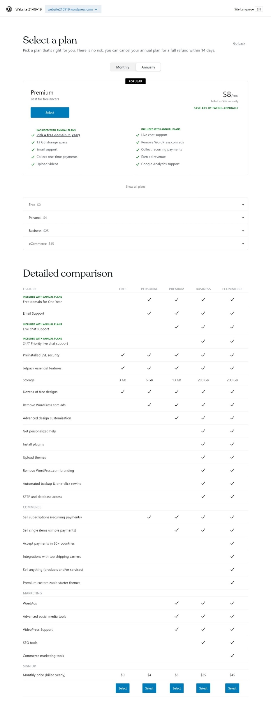
This is your Website Domain Name
Click on Little Down Arrrow
Free $0

Slide 15
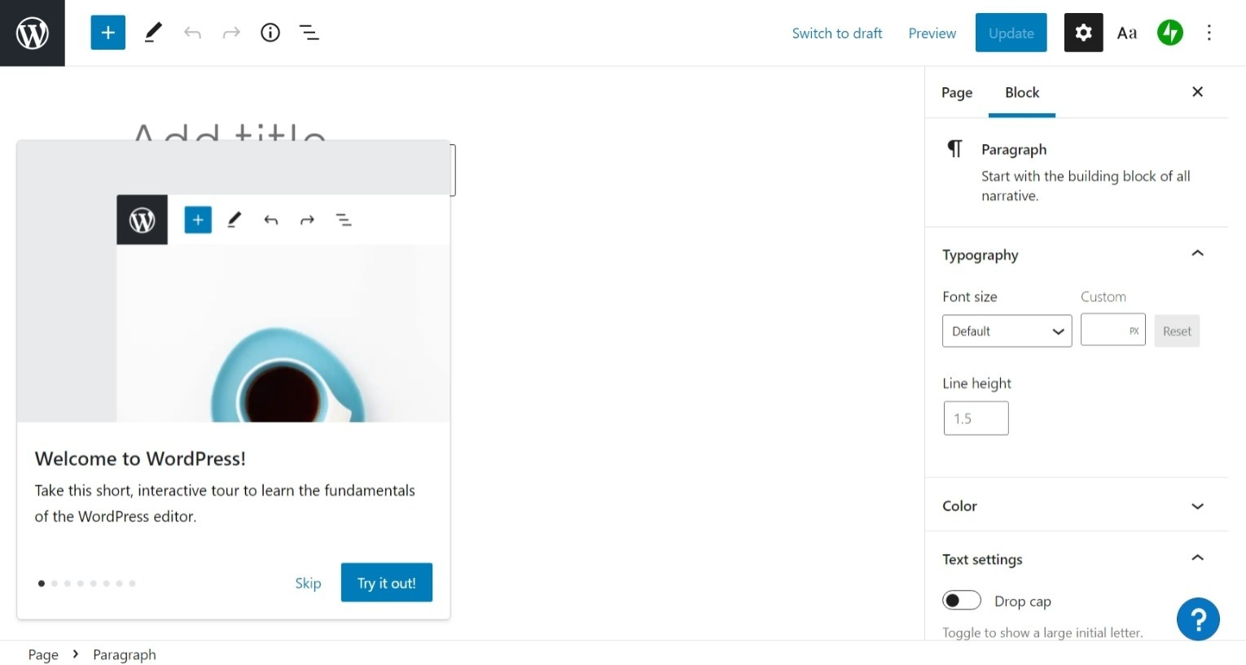
Select Skip to continue

Slide 16
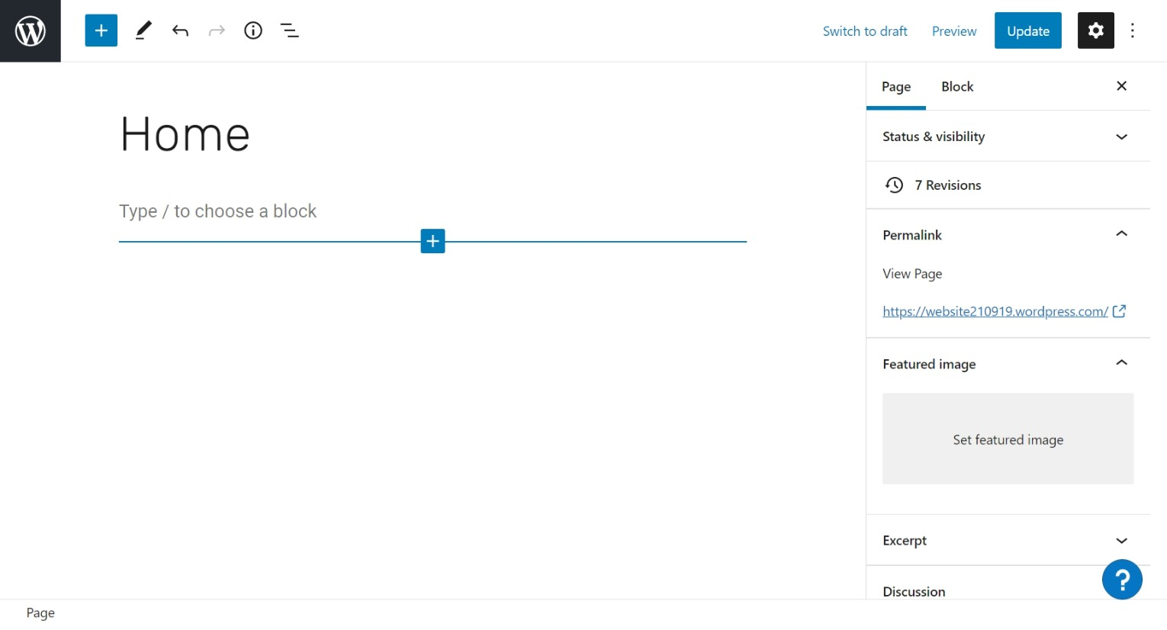
After Entering “Home’ Hit Enter Key
The nwext line will appear
Name of Home page and 1st entry in Menu
Normally it should be “Home”
You will click on the “+”

Slide 17
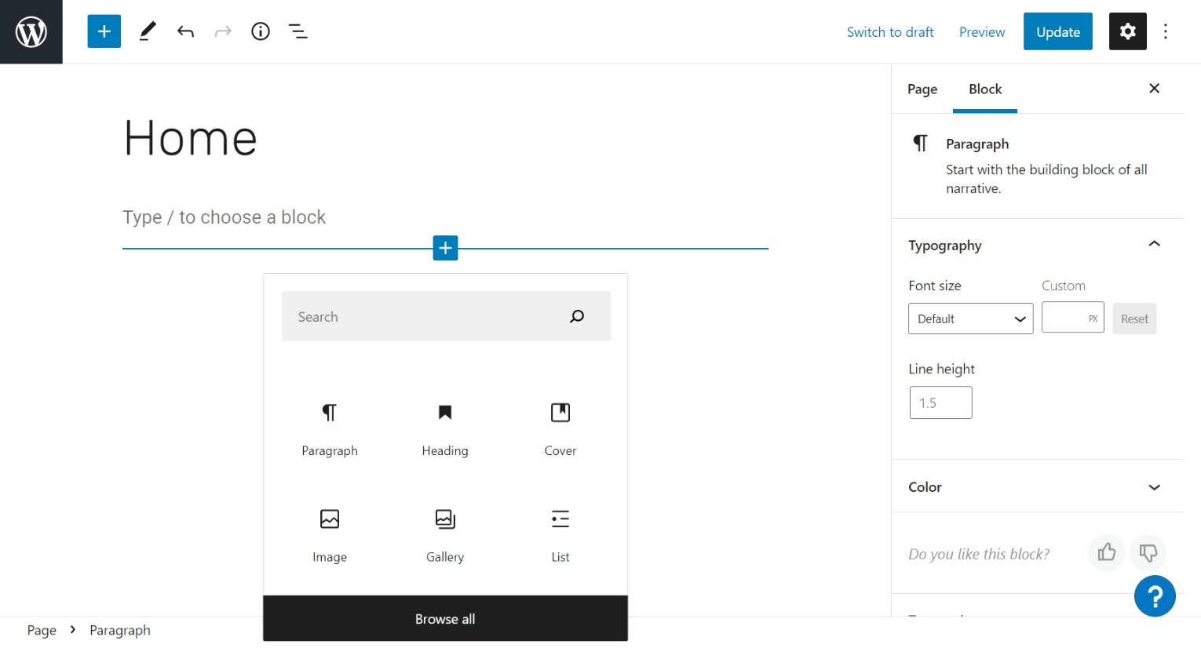
You will select Cover Icon
If it does don’t show then select browse All and find the Cover icon

Slide 18
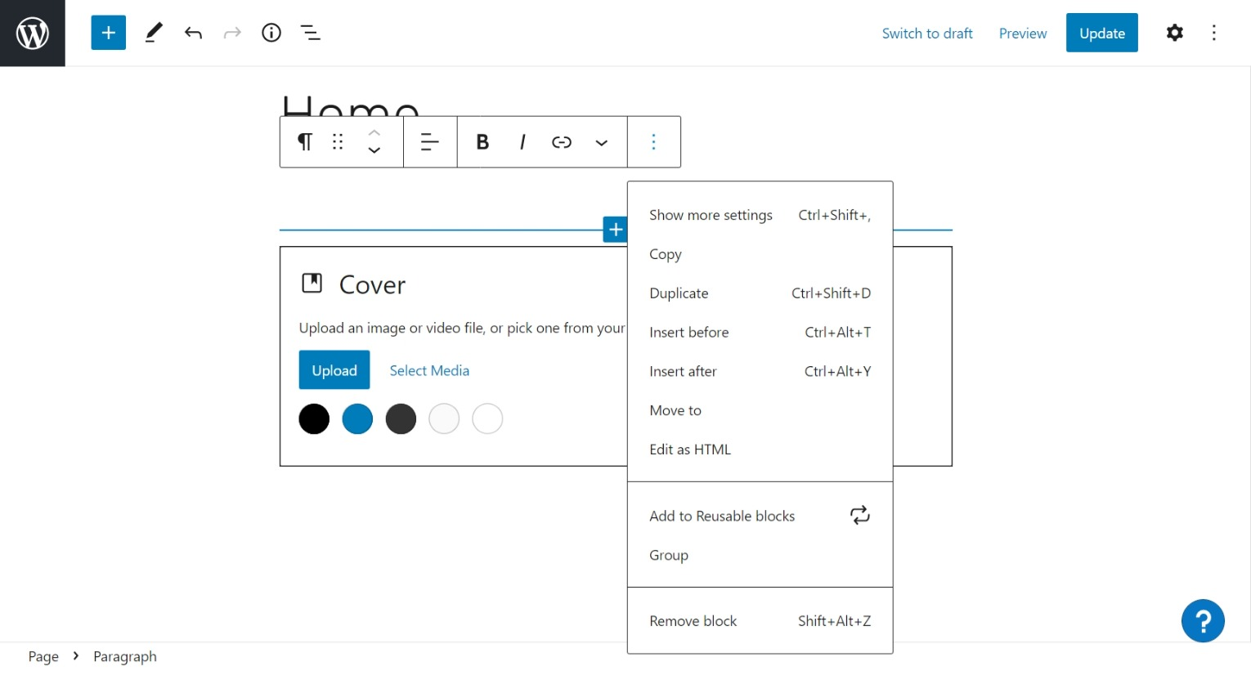
1 st - Click on text “Type to Choose Block”
Then click on 3 dots
3rd – Select Upload to choose photo for Home Page
2nd – Click on Remove Block” to delete

Slide 19
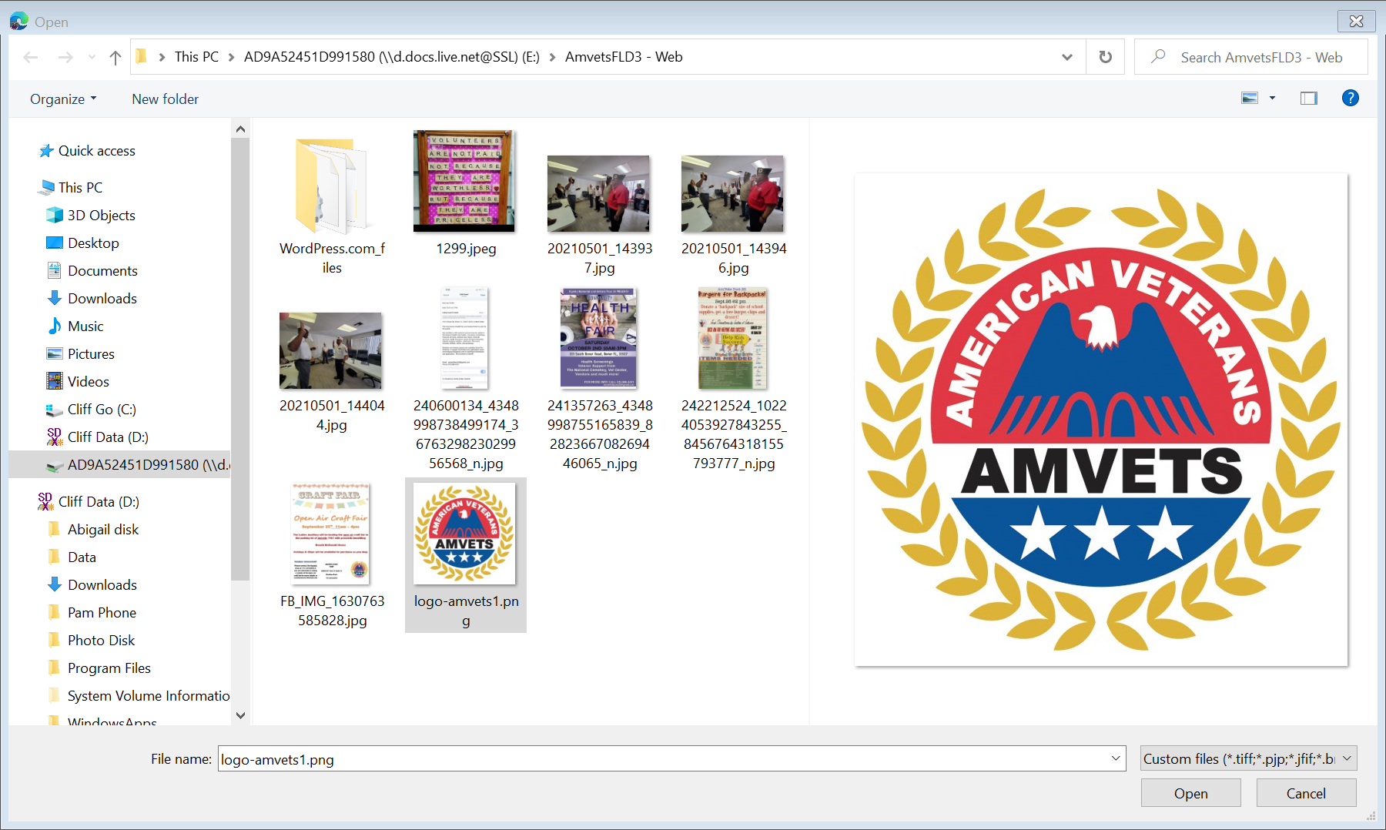
Select Photo for Cover
And click on Open

Slide 20
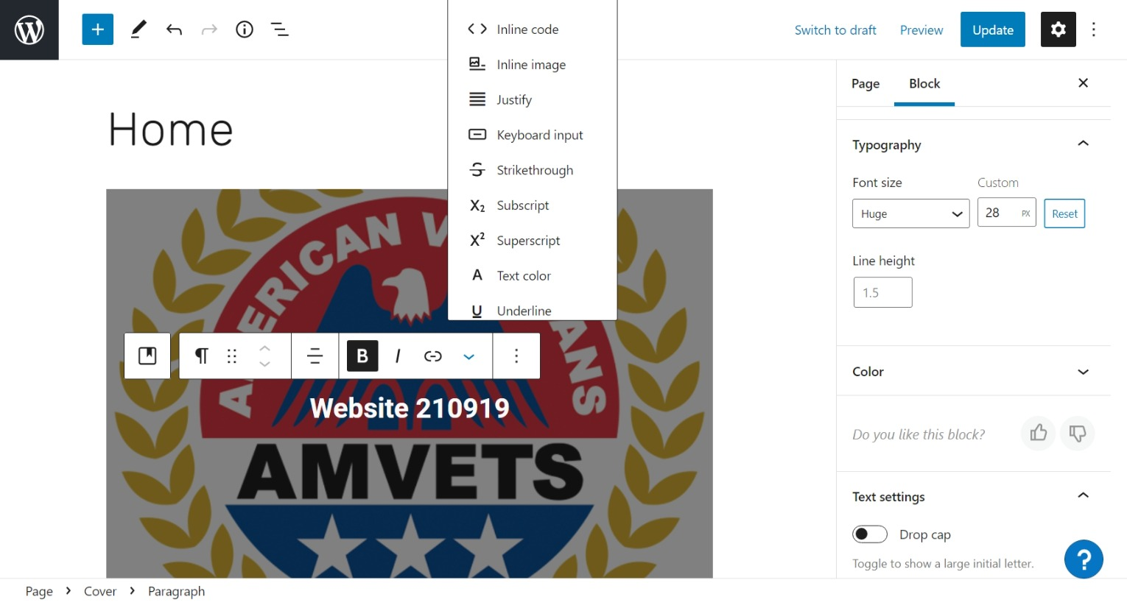
If side bar not in view click on gear
To leave after Update click W
Set other Text attributes
When finish editing select Update or Publish
Change Font Size
Set Bold Text

Slide 21
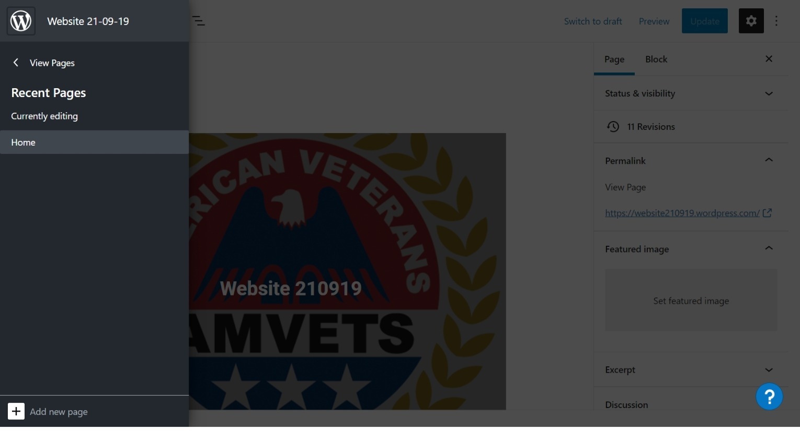
To continue to leave edit page click on View Pages

Slide 22
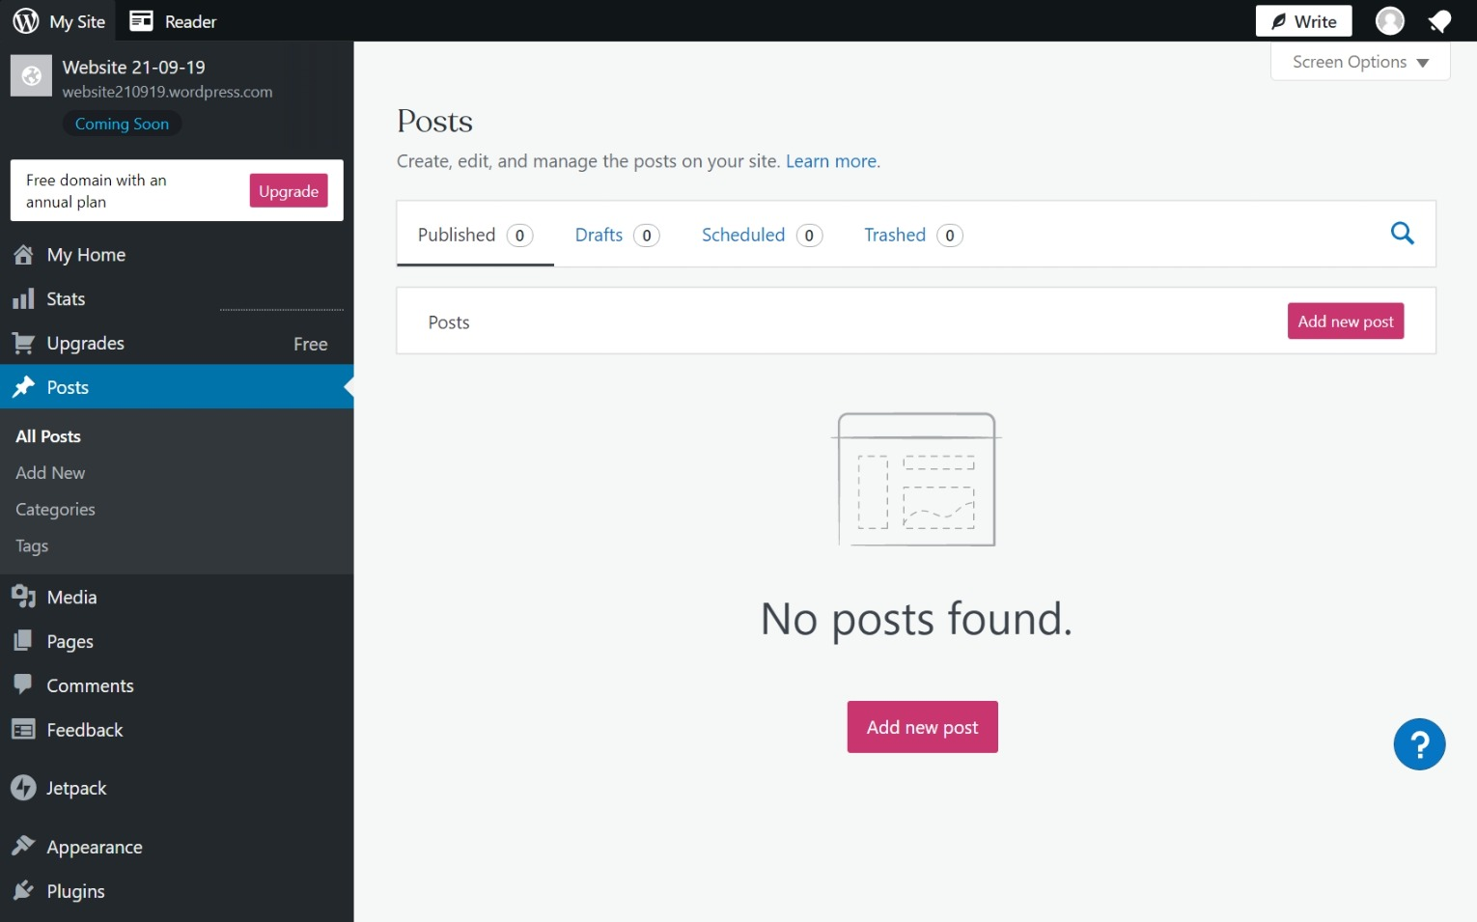
To add categories click Post then Categories

Slide 23
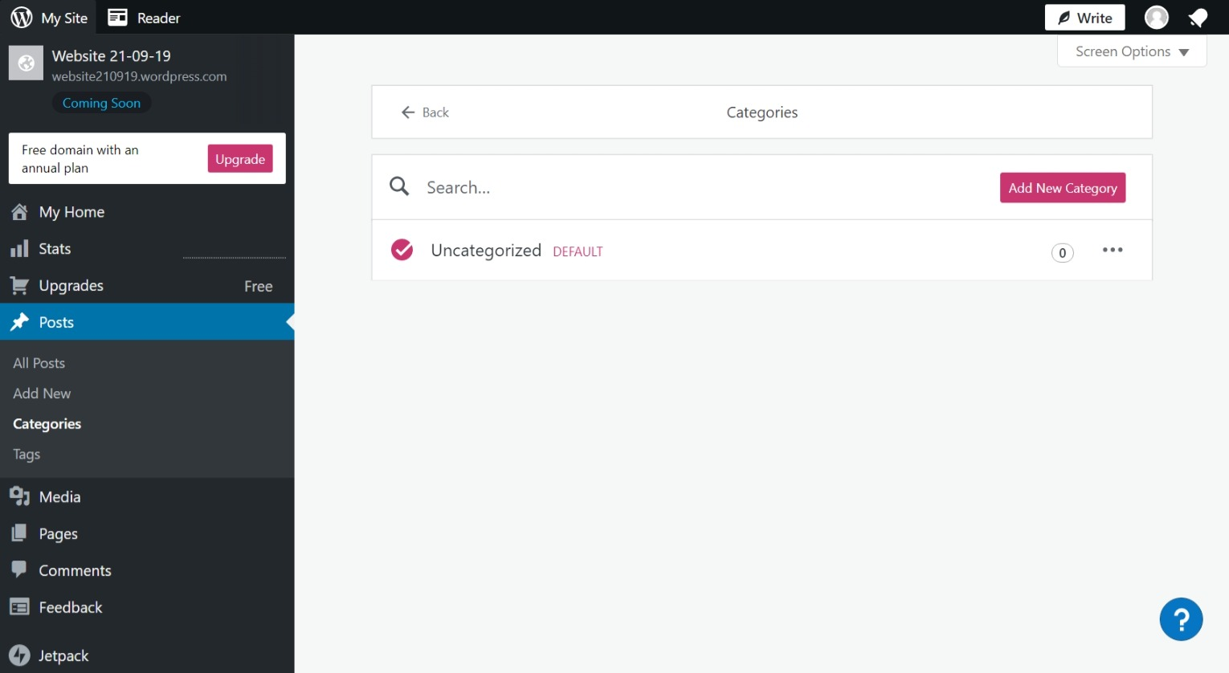
Click on Add New Category
To add new category

Slide 24
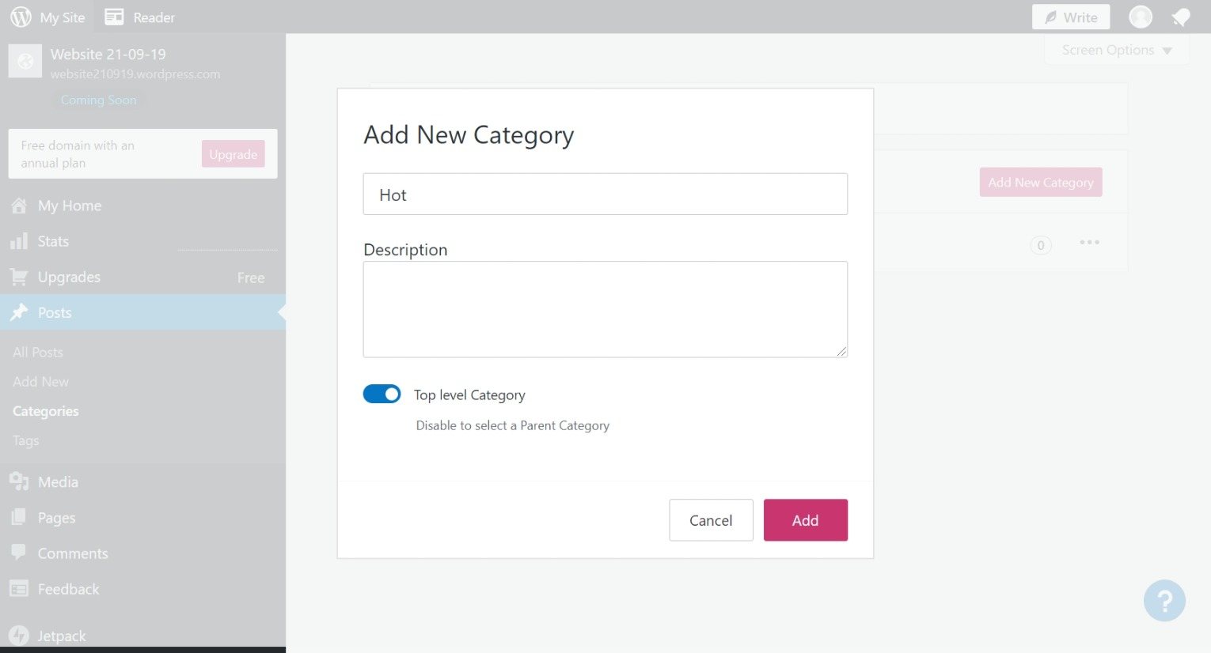
Enter Category Name
Then click on Add

Slide 25
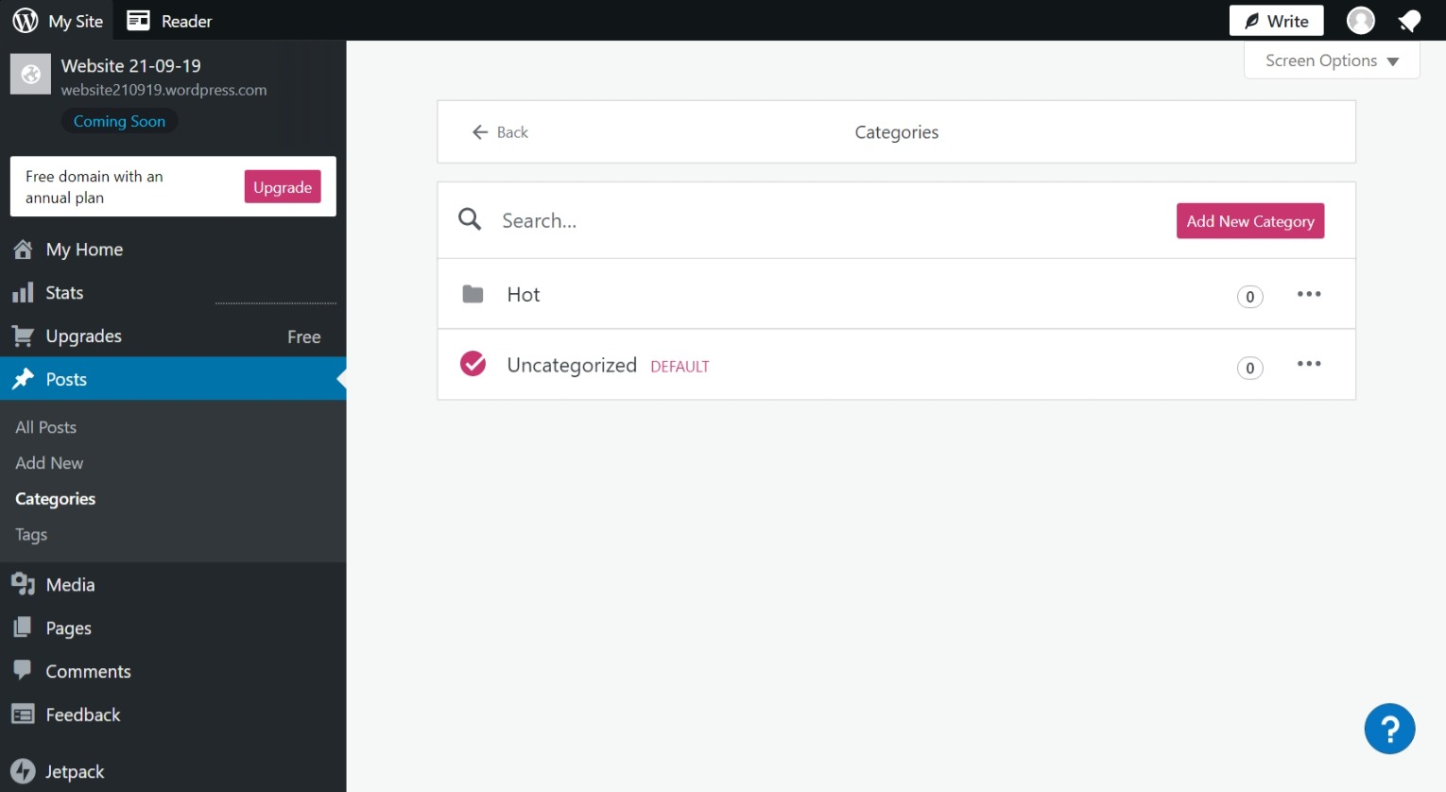
Showes category Hot has been added

Slide 26
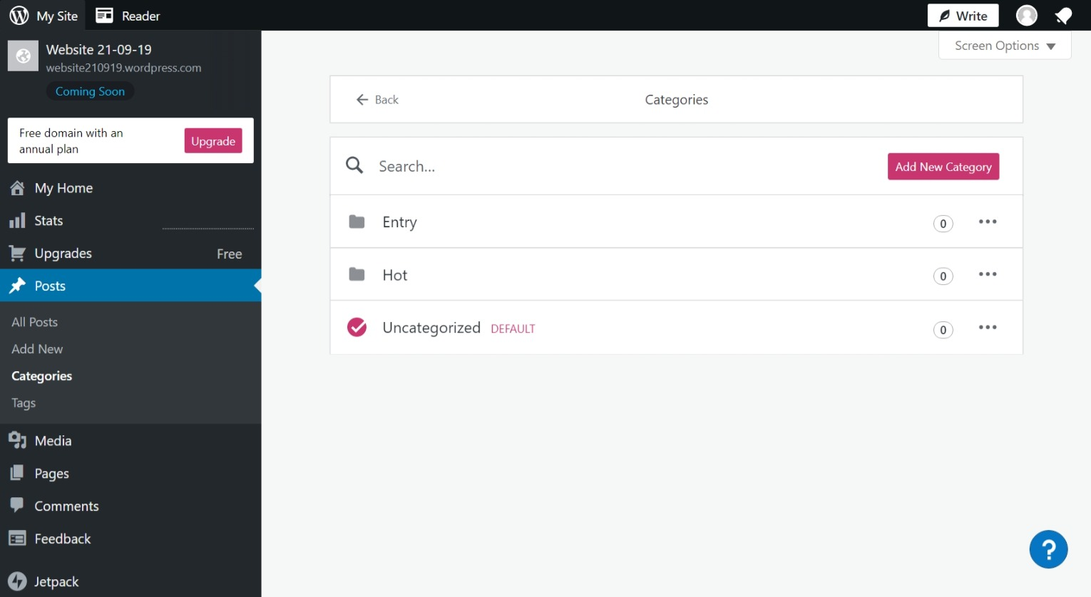
Repeat for Category Entry

Slide 27
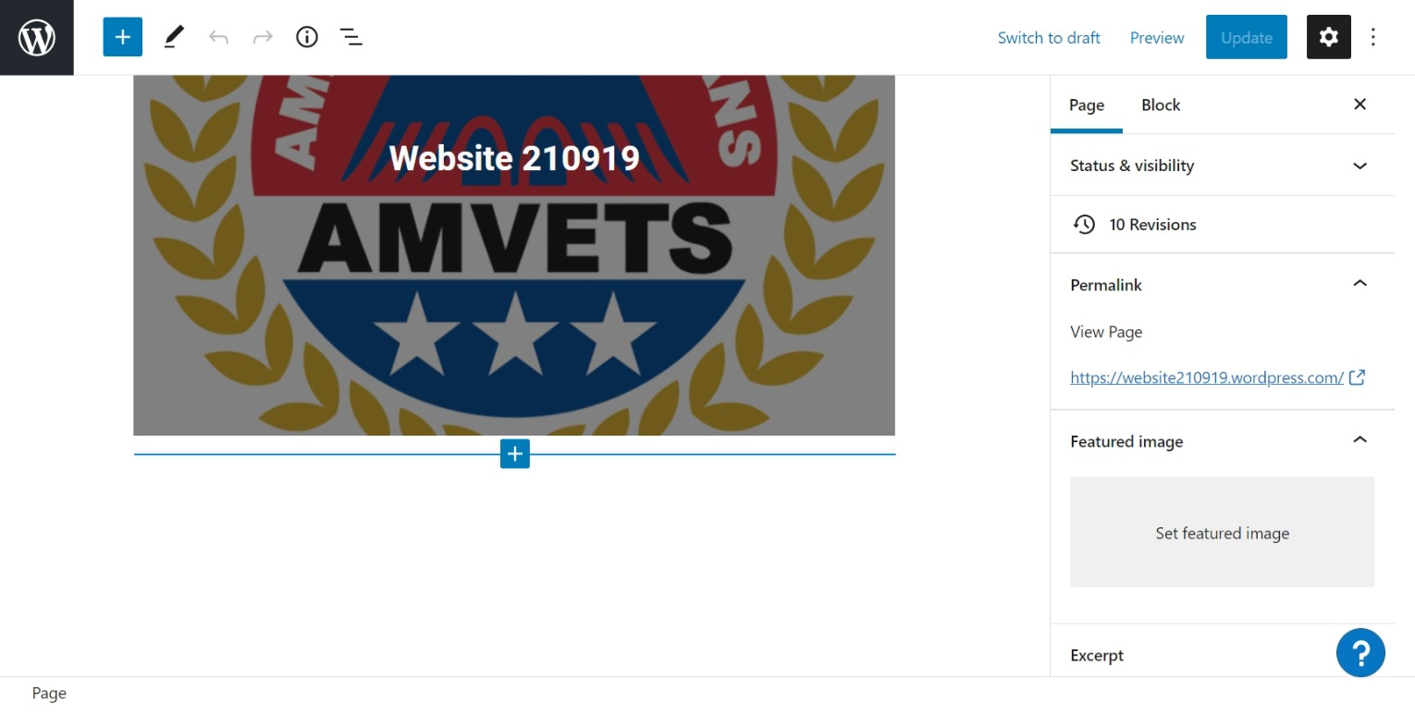
Click on + to add new Text Block

Slide 28
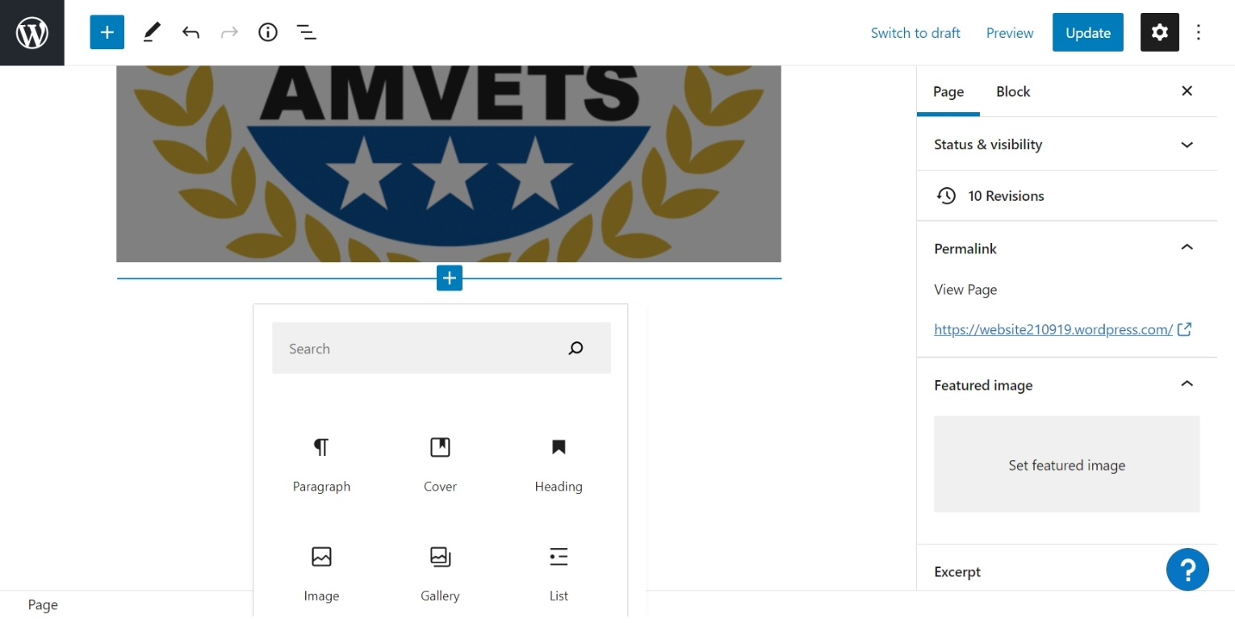
Click on Paragraph for Text Block

Slide 29
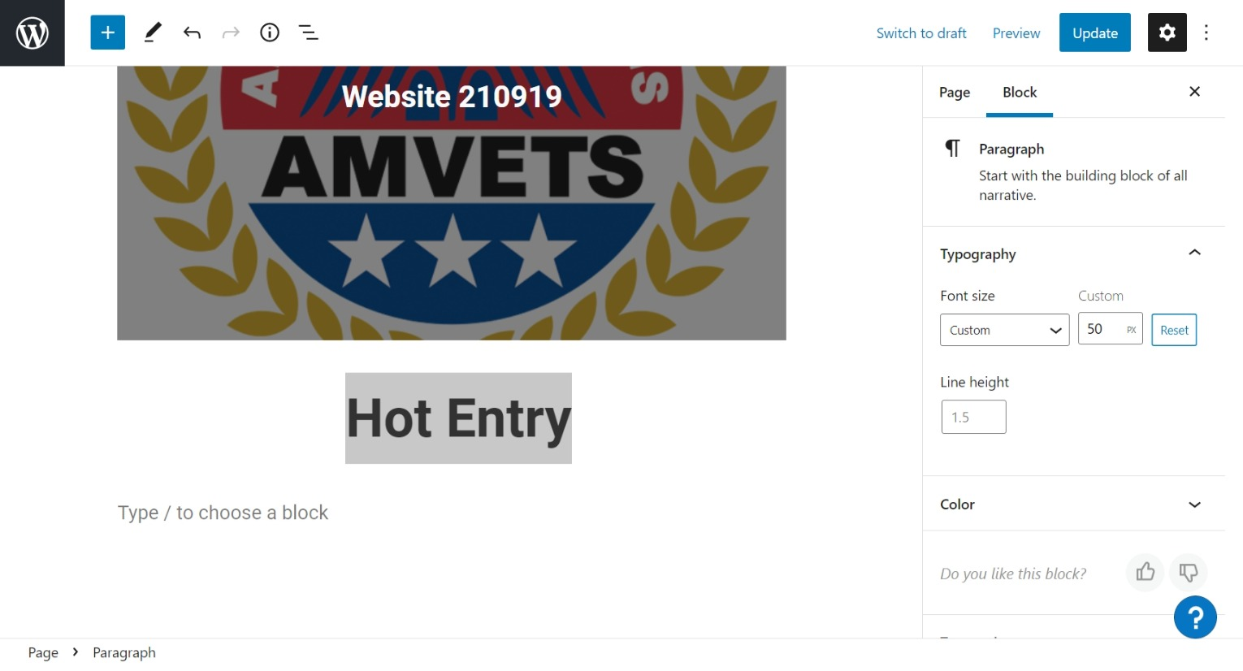
Enter name of info to be added
Change text size by using custom field

Slide 30
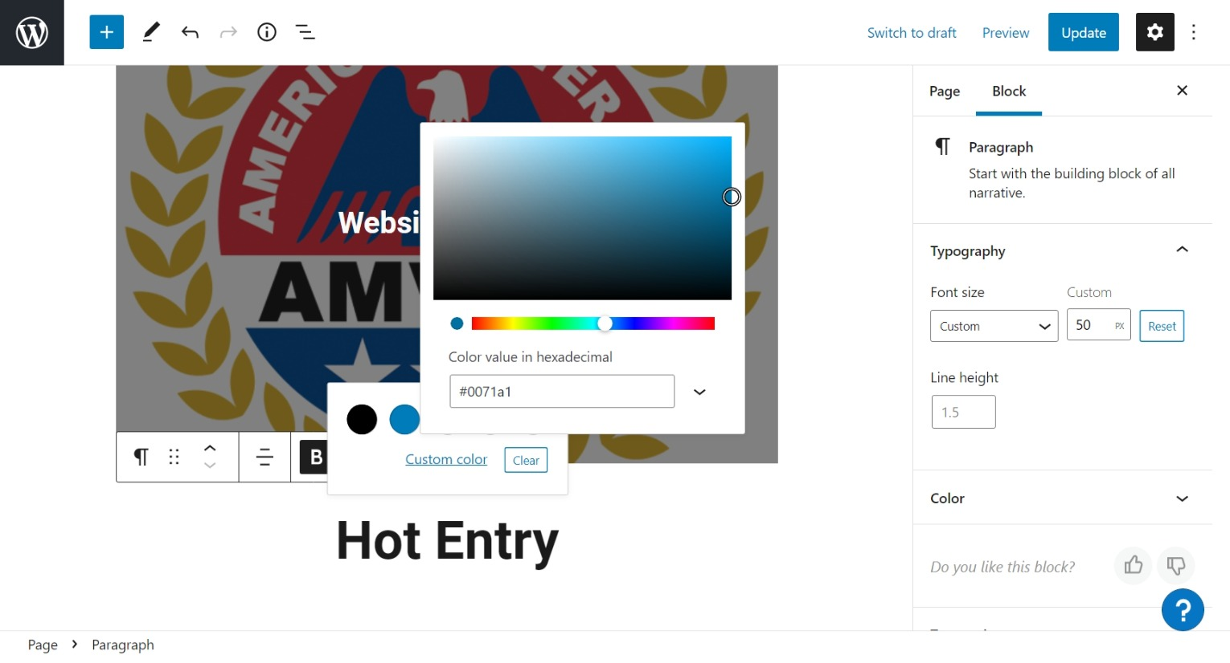
Font Color change by usin
Custom color

Slide 31
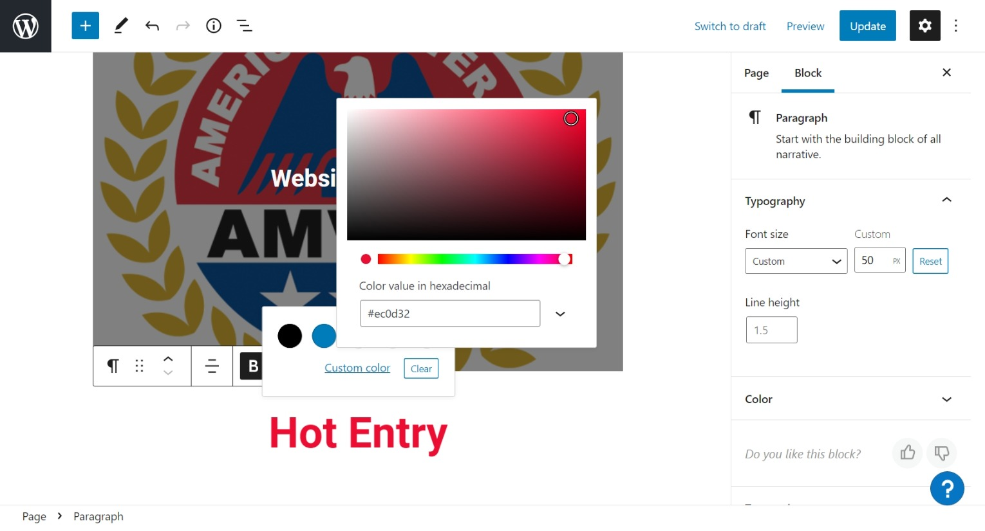
Pick RED

Slide 32
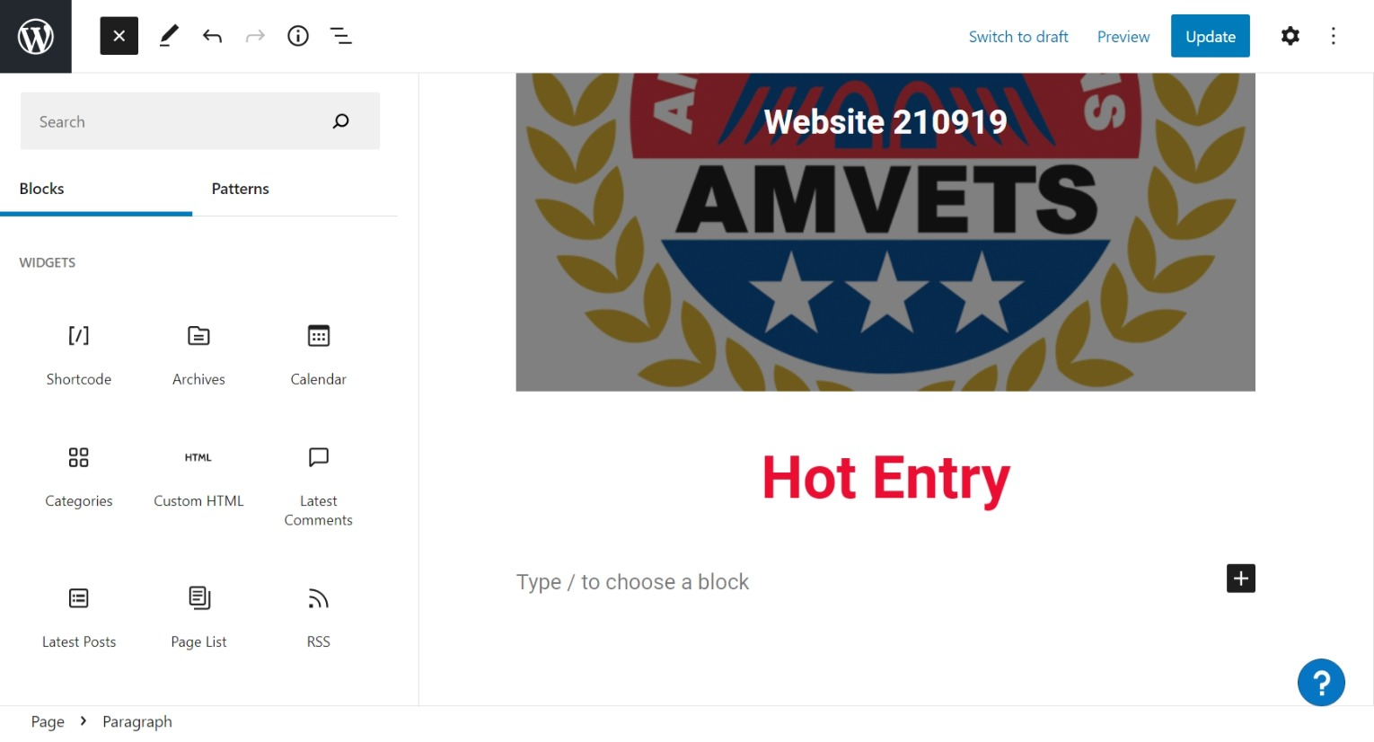
Choose block of Latest Post

Slide 33
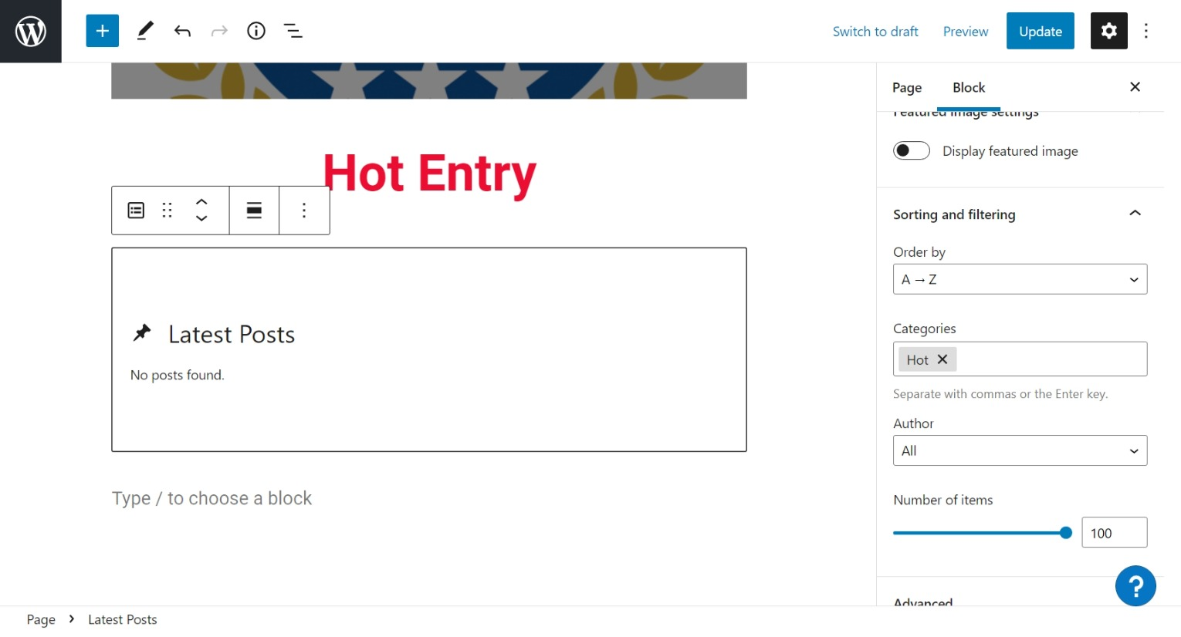
Set order a-z – current to future
Set category to Hot
Max post view is 100
When finished – Update and Leave

Slide 34
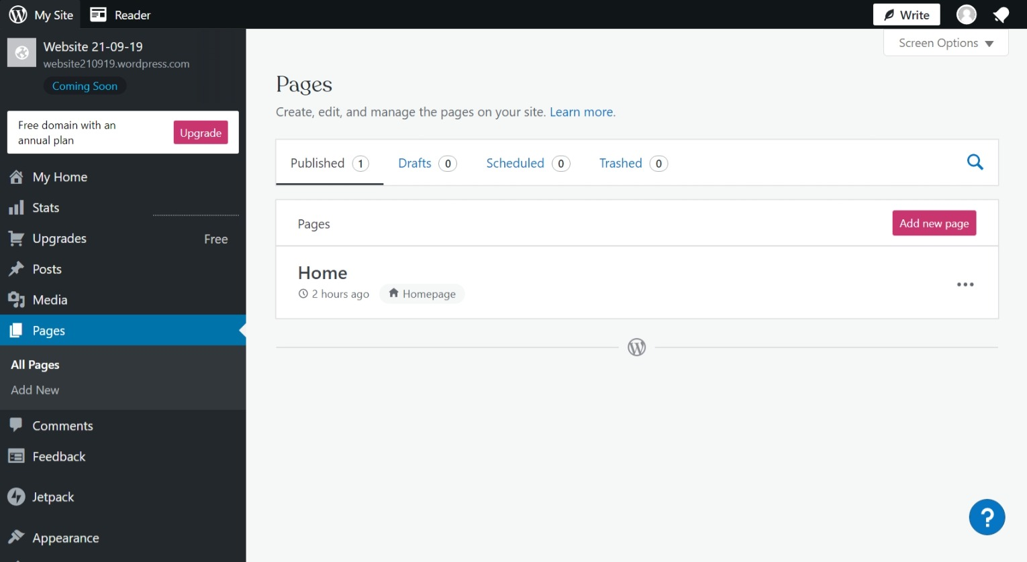
Click on Add New Page

Slide 35
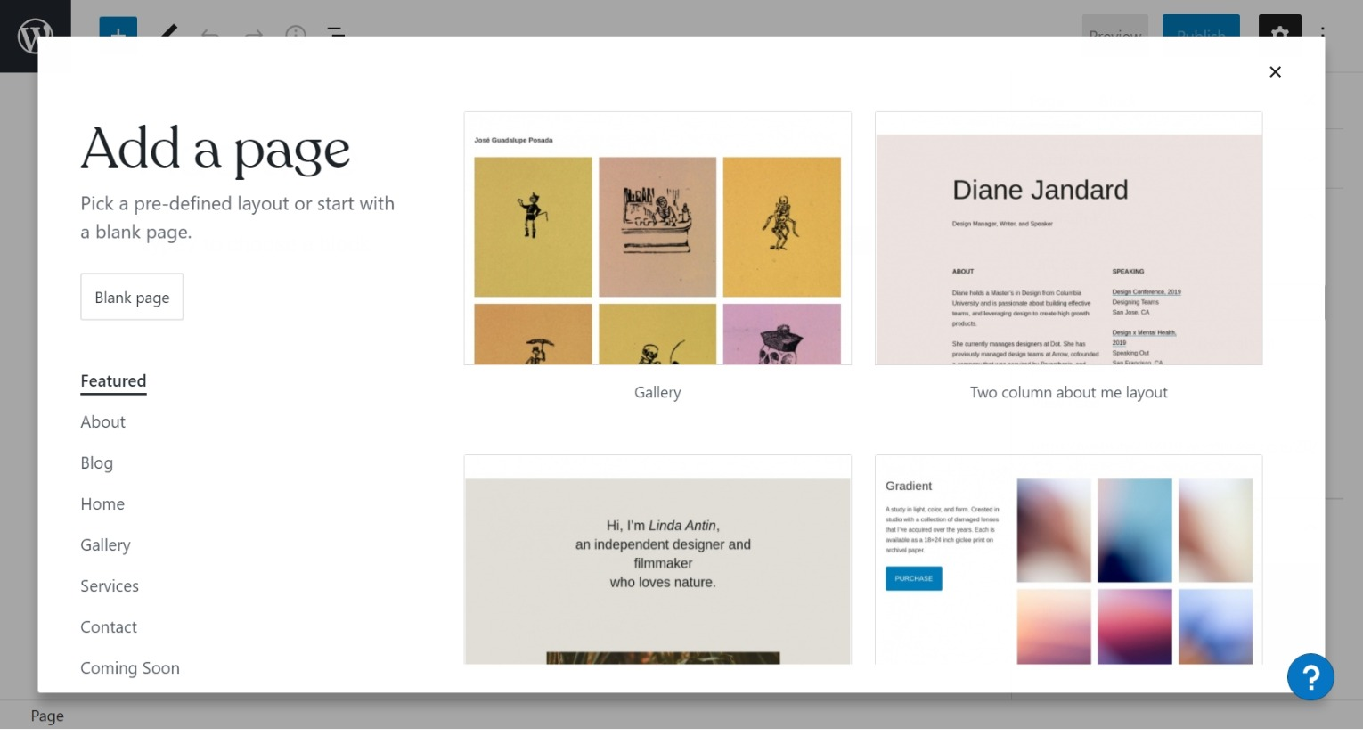
Click on Blank Page

Slide 36
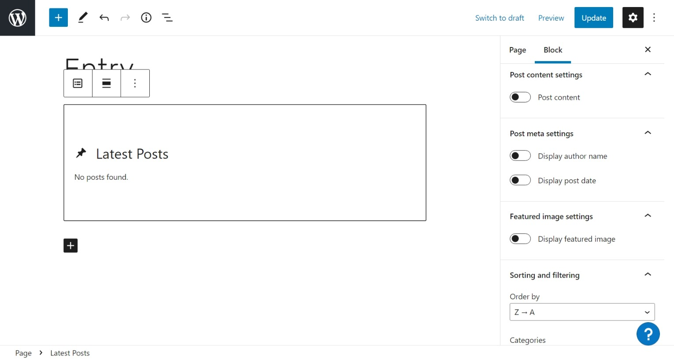
3rd - Turn off Post Content, author name, post date, and feature image
1st - Name New Page
2nd - Add Latest Post Block
4th - Set sort order to Z-A

Slide 37
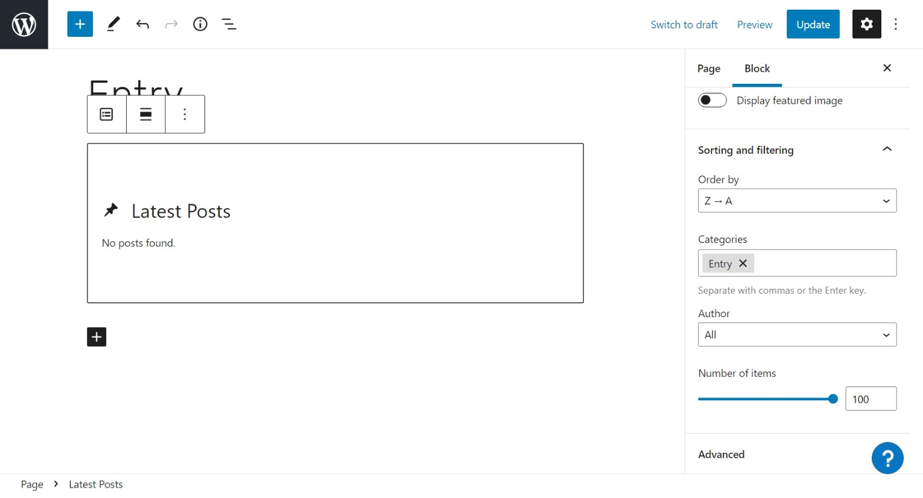
Category to Entry
Set Number of items to 100 – that is max

Slide 38
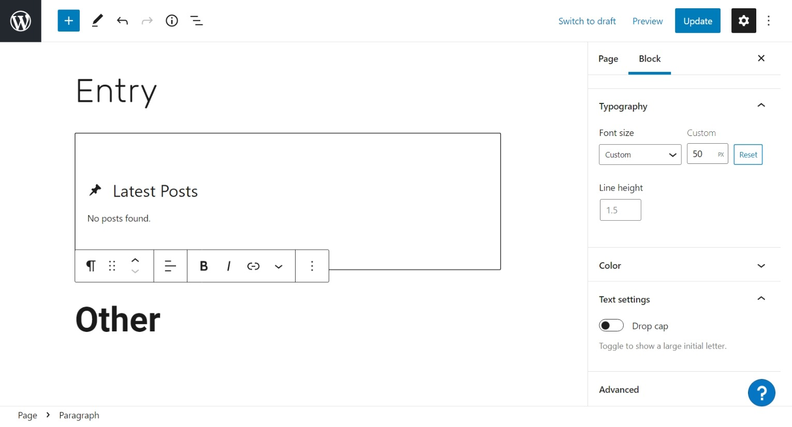
Set Font size to Custom 50
Add Text Block

Slide 39
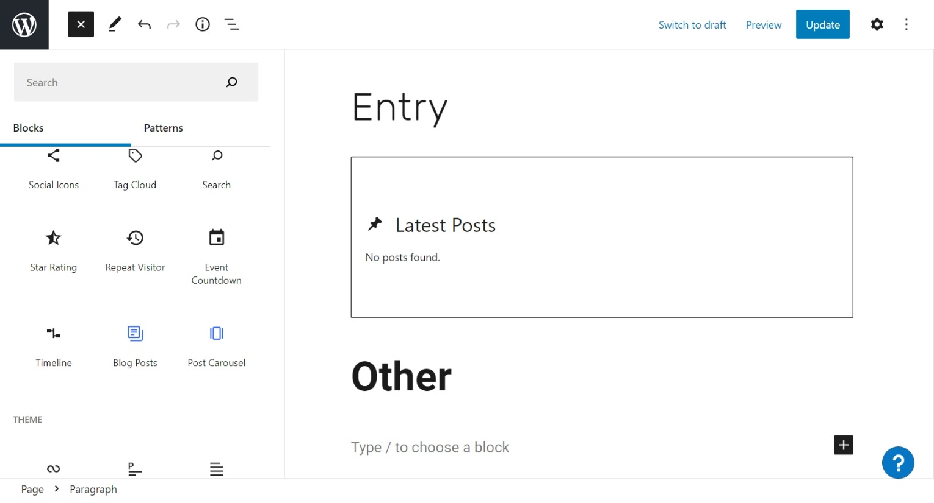
Add a Blog Post Block

Slide 40
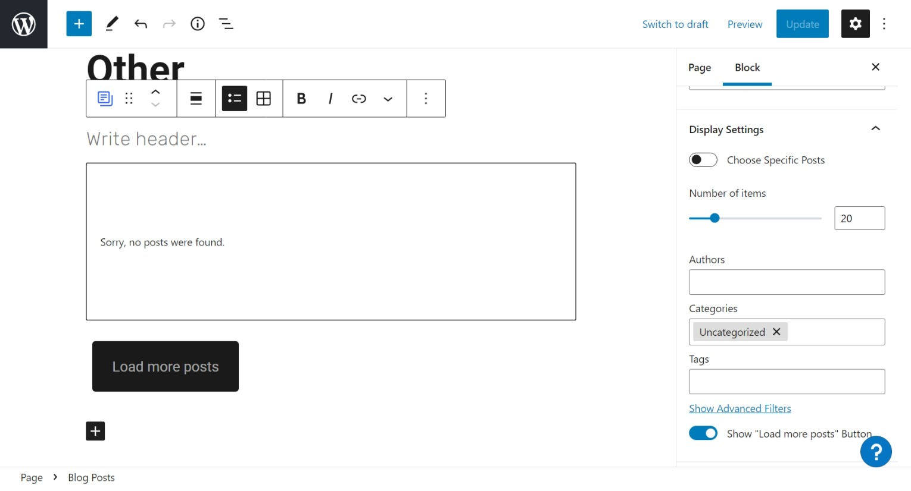
Name of Blog Post Block
Set number of items to 20 – Any number per page
Set Category to Uncategorized
Turn On – Load more Post Button

Slide 41
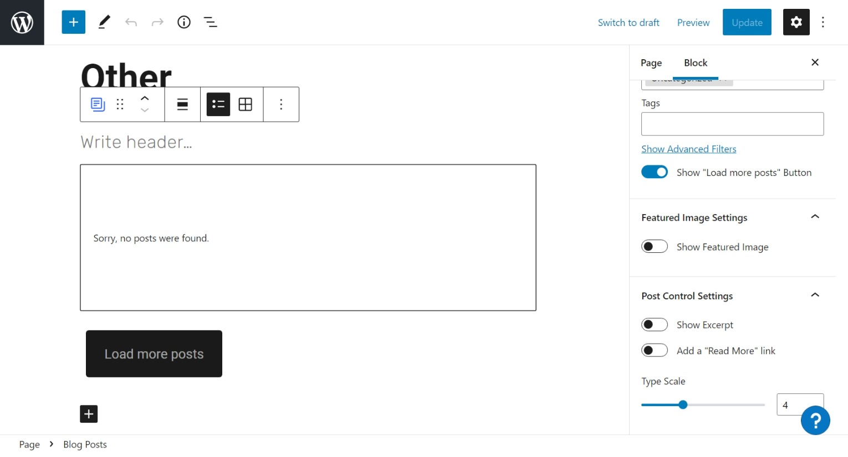
Turn Off – Show Feature Image, Show Except, Read more link

Slide 42
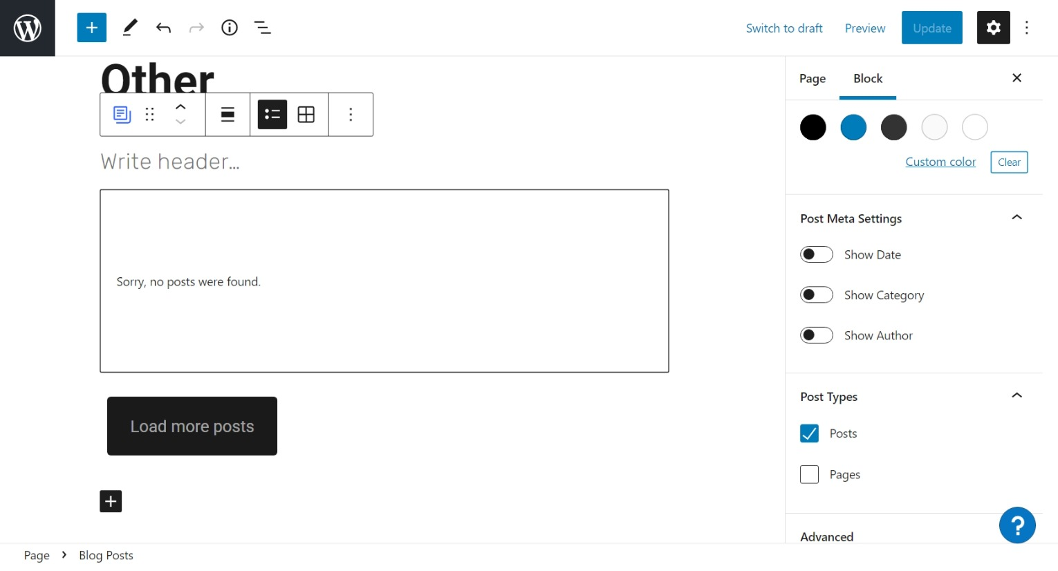
Turn Off – Show Date, Show Category, Show Author
Check Post type as Post
When finish editing – Update or publish and leave

Slide 43
To go to Menu set up Click Appearance then Menu
Click on Appearance then Menu

Slide 44
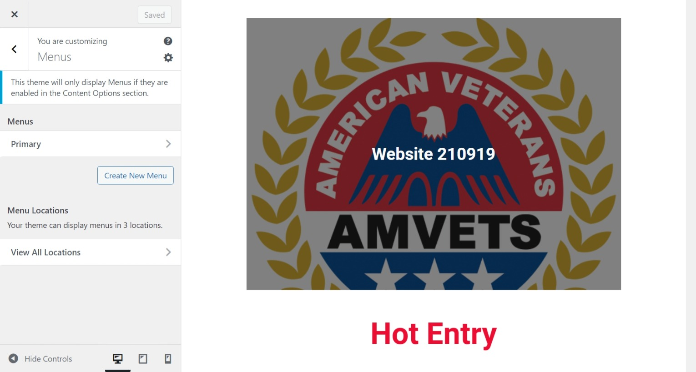
Click on Primary Arrow

Slide 45
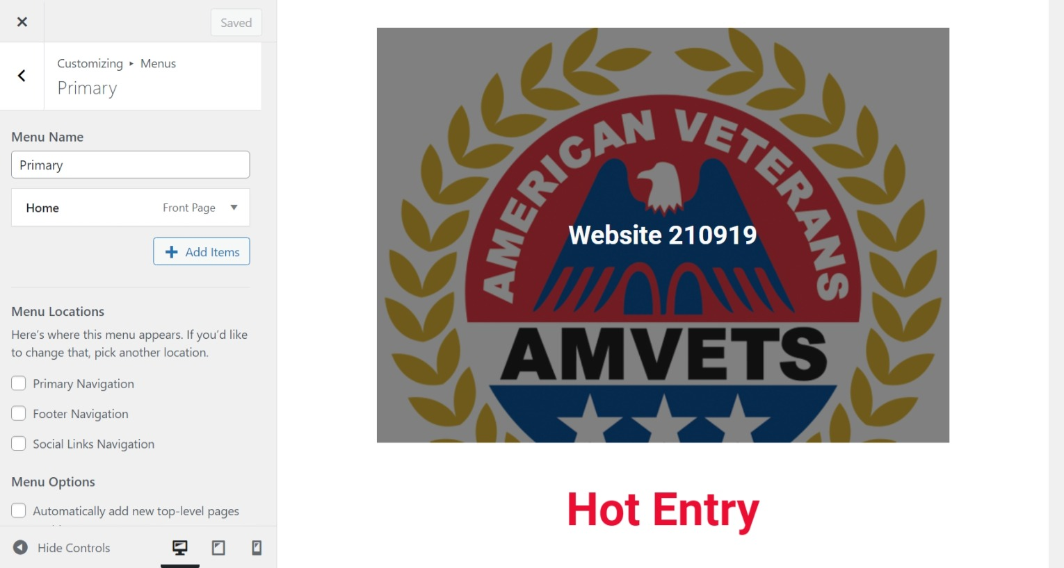
Click on Add Item – to add menu item

Slide 46
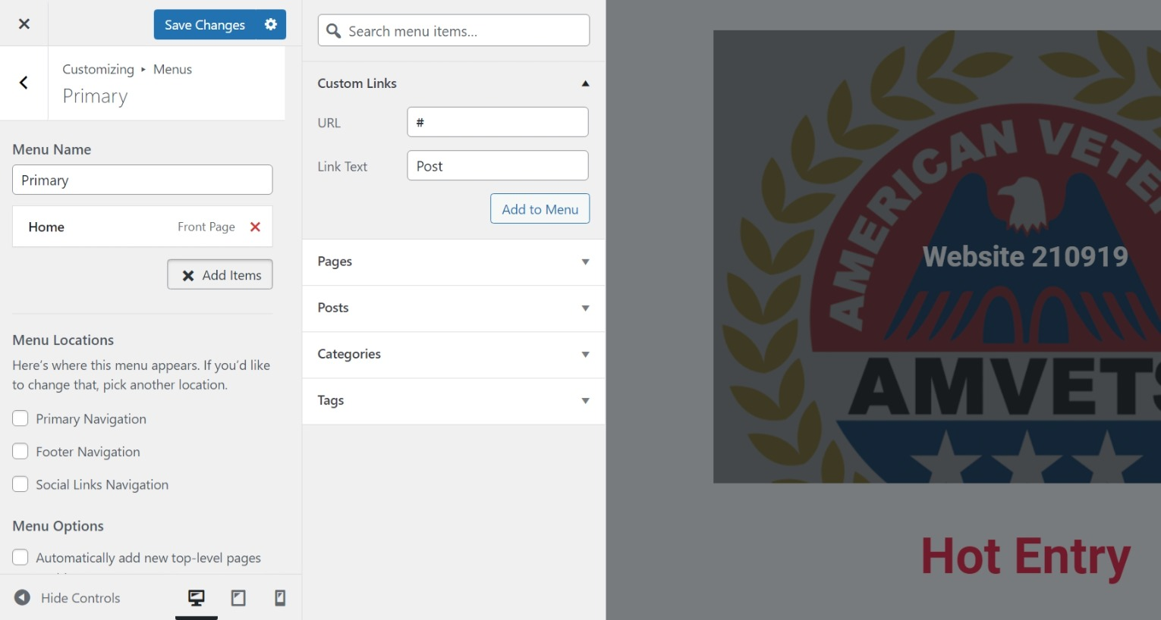
1st - Click on Custom arrow
2nd – enter # in url – Menu header item
Then enter header name –”Post”
3rd – click add to Menu

Slide 47
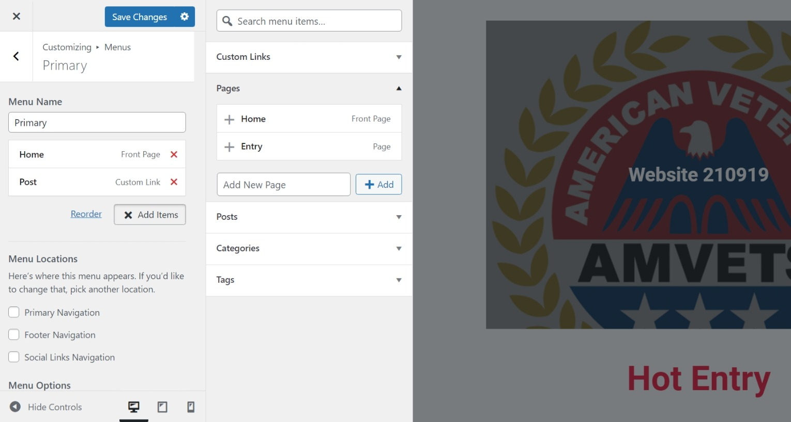
2nd – click page arrow
3rd – Click on Entry +
1st click add menu to add entry page to menu

Slide 48
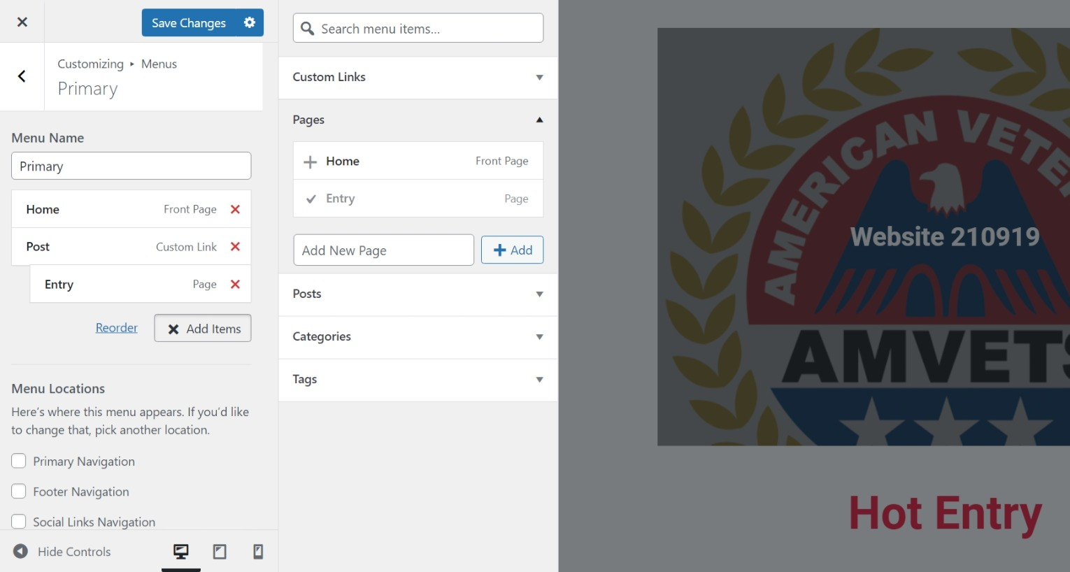
Move Entry menu item over as showen

Slide 49
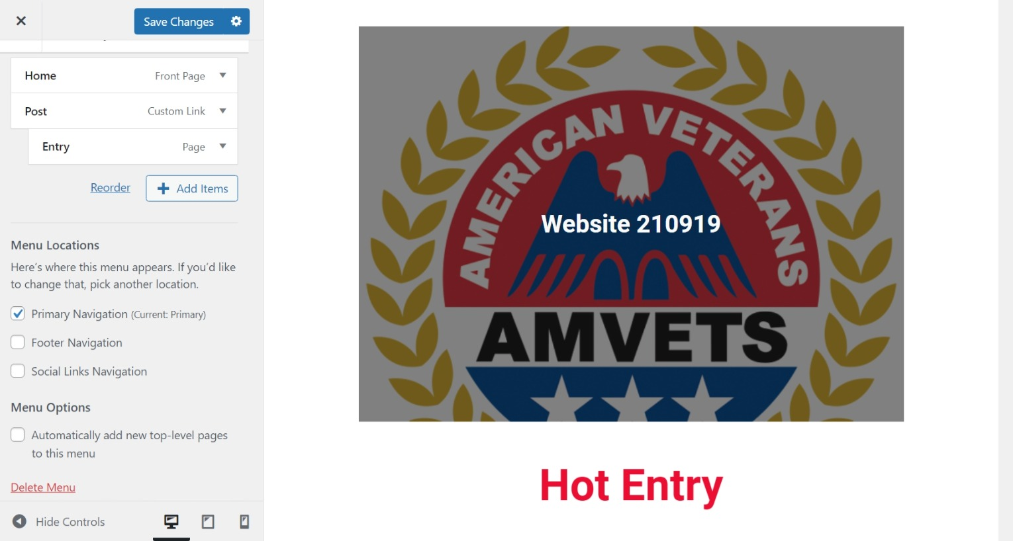
Check Primary Navigation

Slide 50
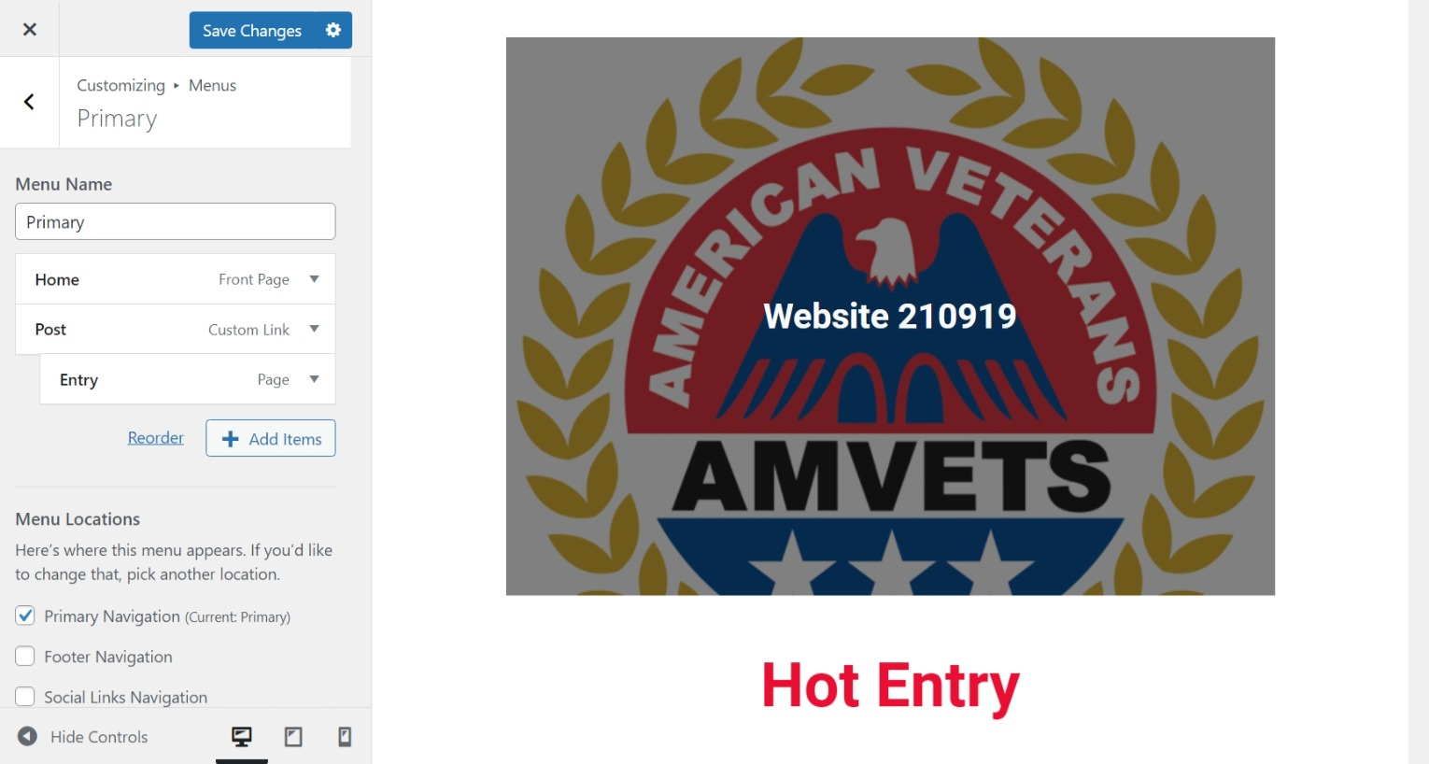
1st – click save changes
2nd – click Save Changes X

Slide 51
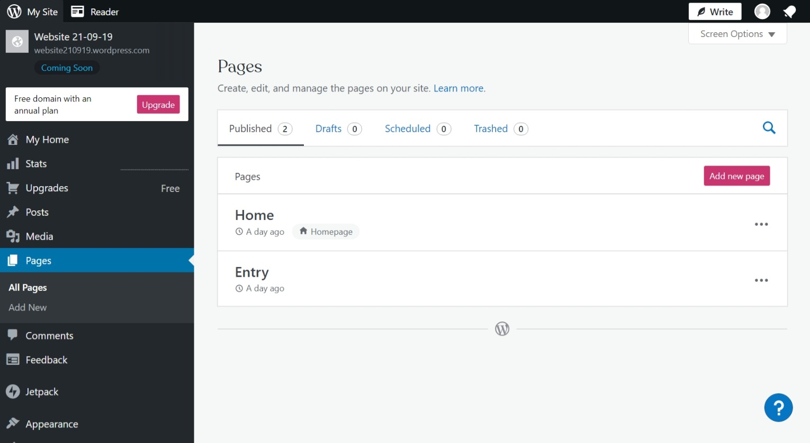
We will now Launch Site
Click on Box next to Website 21—0-19

Slide 52
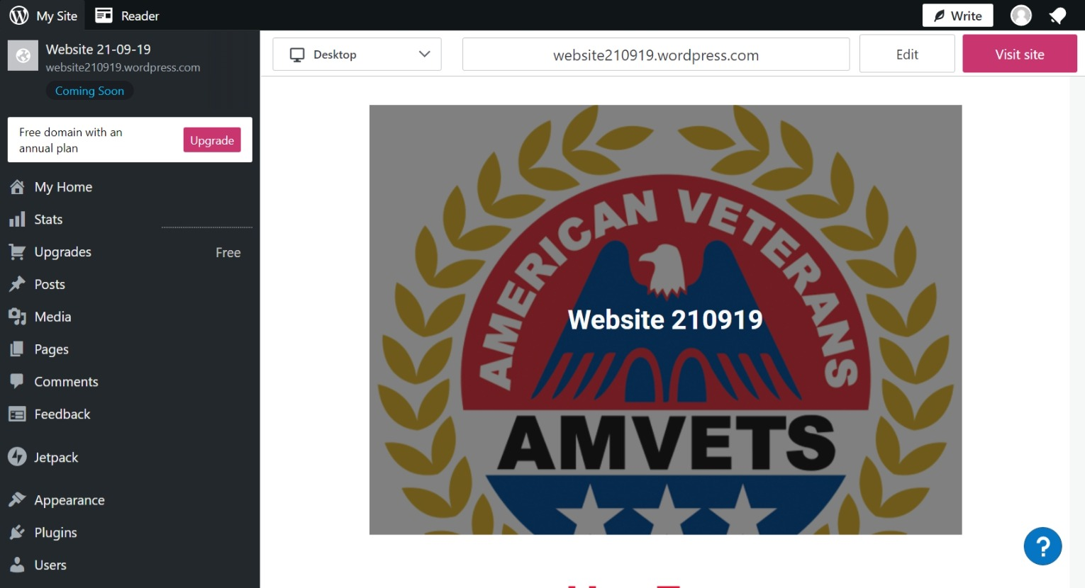
Click on visit site

Slide 53
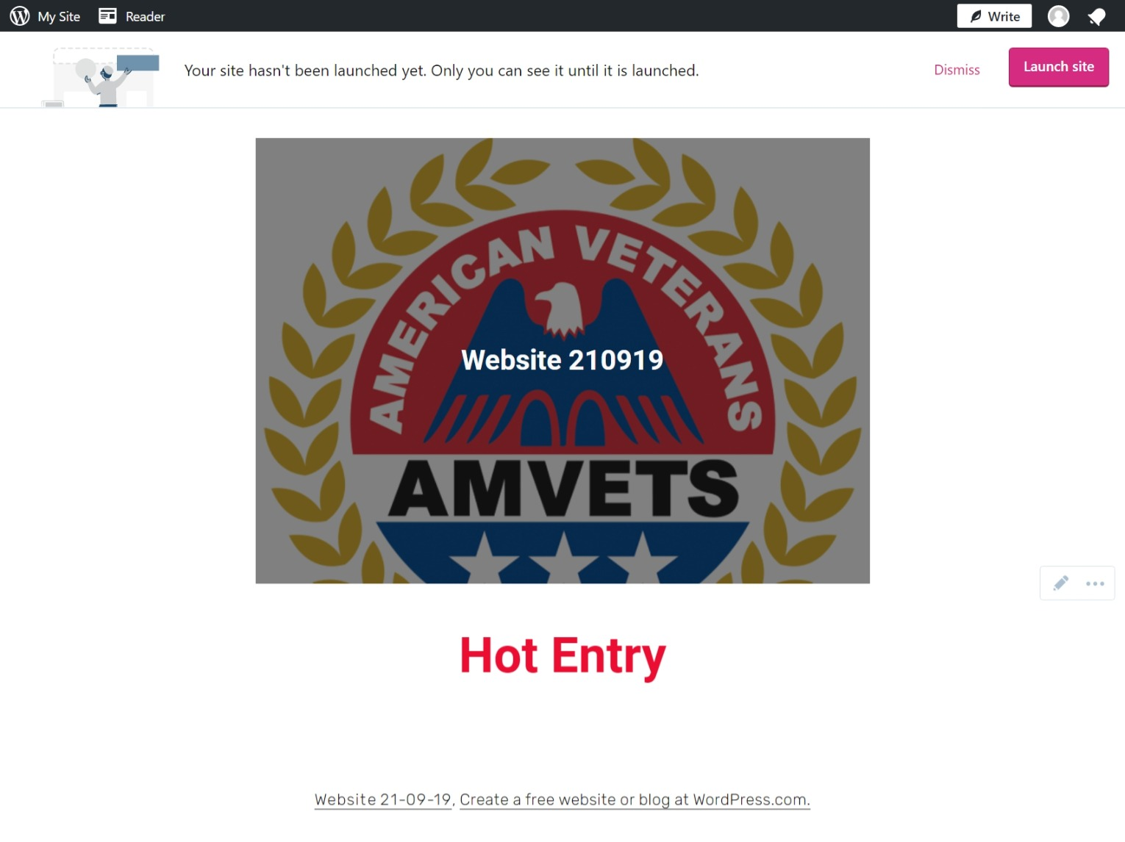
Click on Launch Site

Slide 54
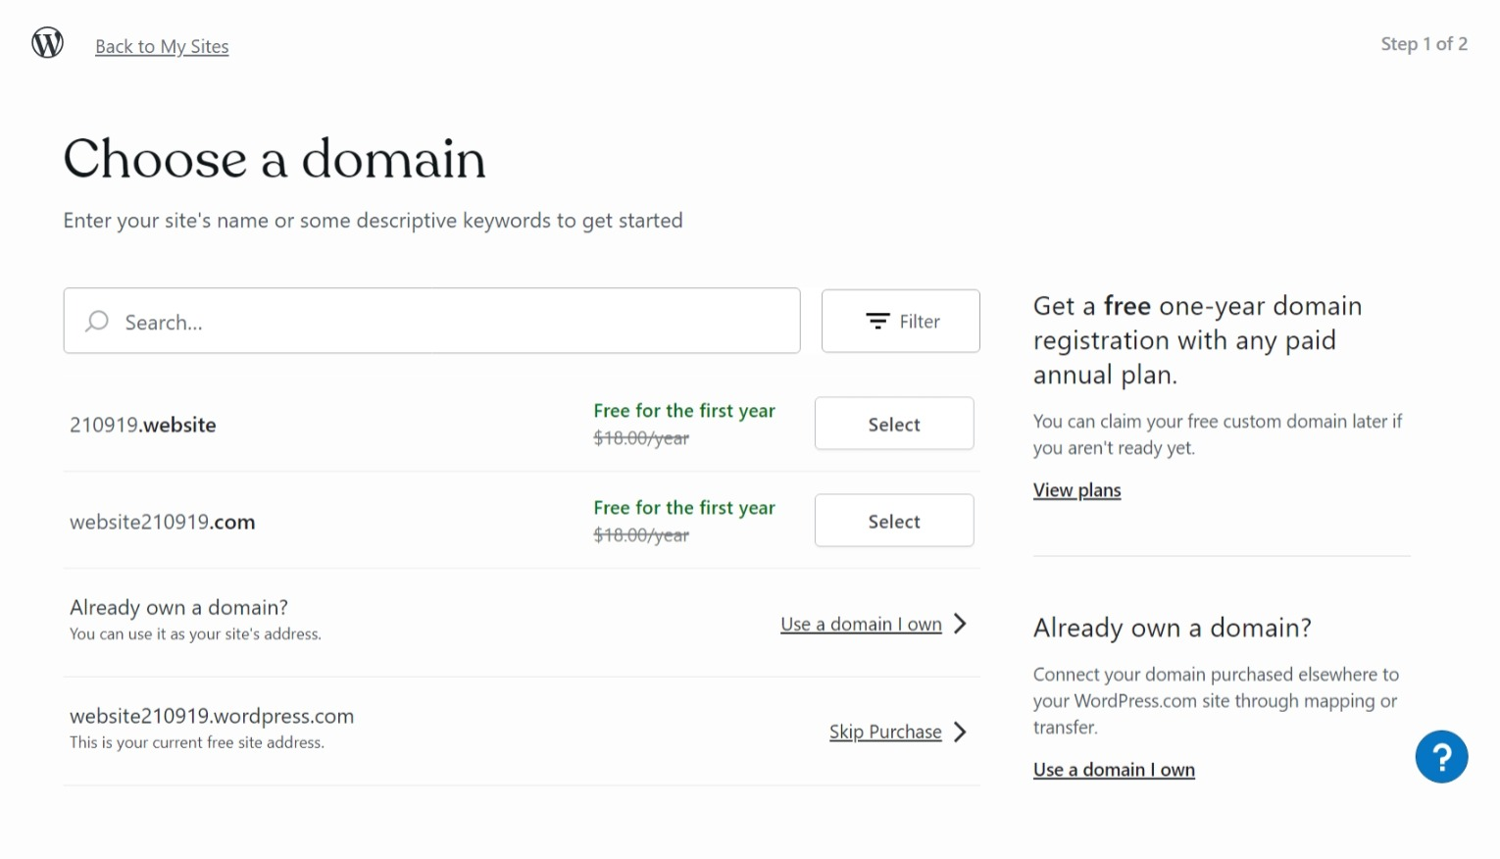
Click on Skip Purchase

Slide 55
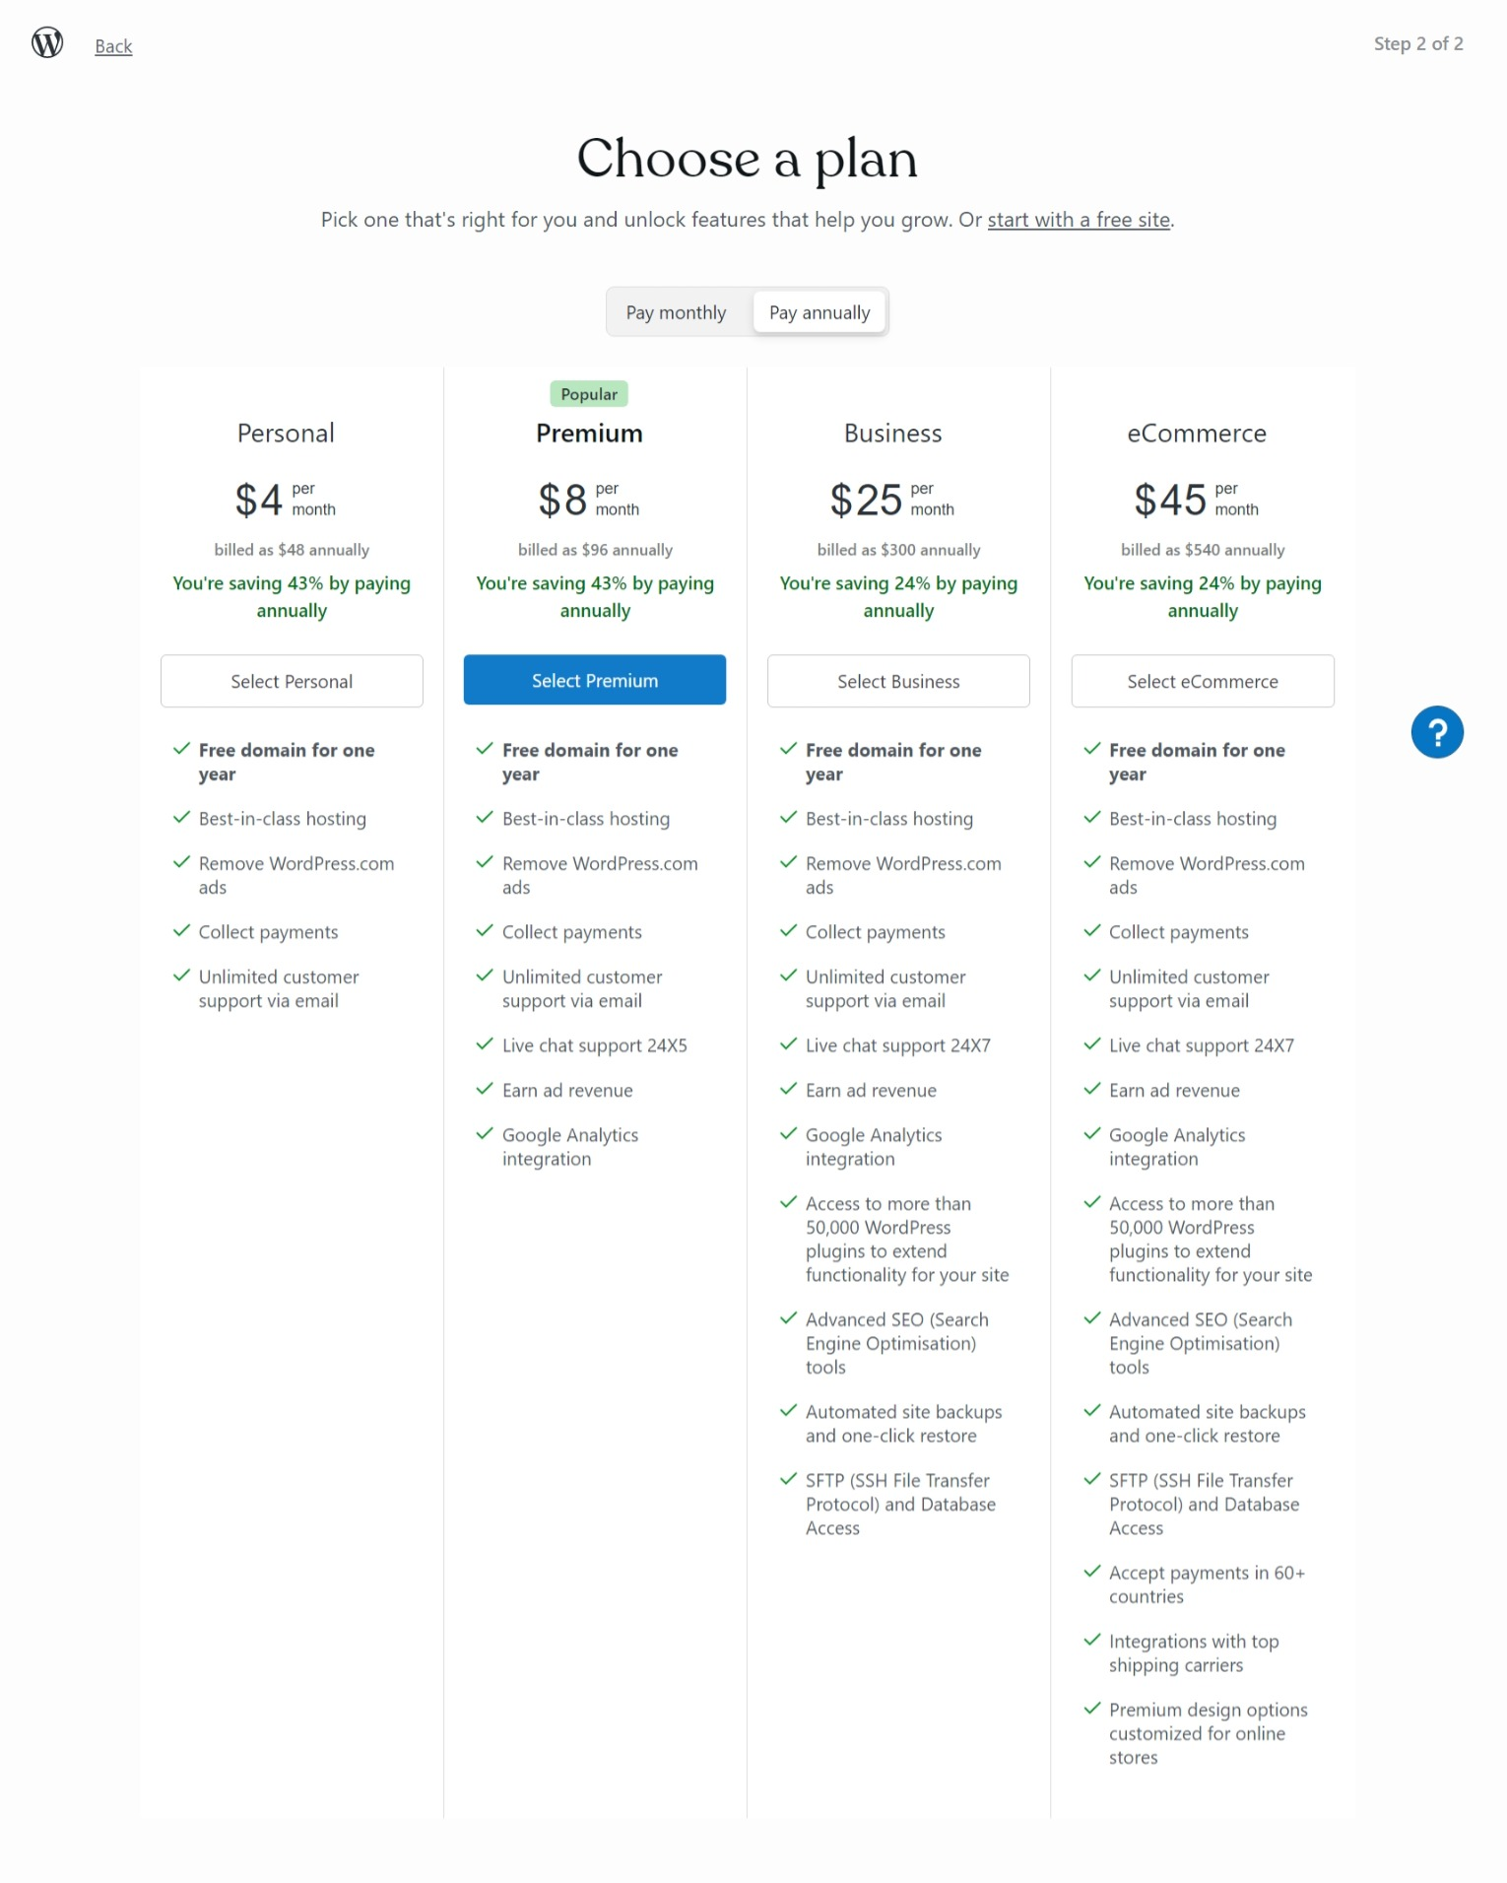
Click on Start with a free site

Slide 56
Click on Appearance then Customize

Slide 57
Click on Content Option Arrow

Slide 58
3rd Click on Content Option Arrow
1 st - Check Enable Header and top menu
2nd – Check Show Post and Page Titles

Slide 59
2nd – Click on Save Changes then the X
Click on Site Identity Arrow
1st - Enter Web Site Name in Site Title

Slide 60
2nd – Click on Add New Post
1st – Click on Post

Slide 61
1^{s} – enter Post Title – for Events Enter date as yy-mm-dd
3rd – Click on Gallery Block
2nd – Click on Add Block

Slide 62
Click on Upload

Slide 63
1st - Click on Image you want
2nd – Click on Open

Slide 64
With Post Set
Turn off AMP

Slide 65
With Post Still set
Set Category for Post o be Viewed

Slide 66
When Finished – Click Publish or update
for Galley Block – set Block
Turn off Crop Image

Slide 67
To edit a Post Click on Post

Slide 68
Click on post you want to change or edit

Slide 69
While set to Post
Change Category to only Uncategorized

Slide 70
While still set to Post
When finished – Update and Leave
Since Block is a Blog Post Block you need to changed the Published date to date of function

Slide 71
Need Help – Got Questions
Contact your Friendly PRO / Webmaster
Email – amvetsflpro@gmail.com
amvetsfld3.wordpress.com
amvetsflpost8.org

